Slide 1
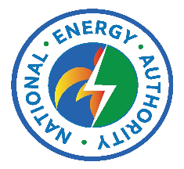



Empowering Rural Papua New Guinea —
The Baluan Solar Breakthrough
Baluan Island leads the way in off-grid solar energy adoption in PNG.
100kW solar panels and 215kW battery storage provide reliable power.
Project serves as a scalable model for rural electrification across PNG.
Improves quality of life and economic opportunities for local communities.
Demonstrates synergy of technology and community engagement in energy access.
Image courtesy of Sak Energy 2025
Image courtesy of Sak Energy 2025
Notes:
This slide highlights the socio-economic benefits derived from the Baluan Solar Breakthrough. Reliable electricity enables businesses to operate efficiently and schools to provide better learning environments. Healthcare facilities gain power for critical equipment, reducing dependence on diesel generators, which are costly and polluting. The project empowers the community toward sustainable energy independence and fosters overall social and environmental progress.

Slide 2
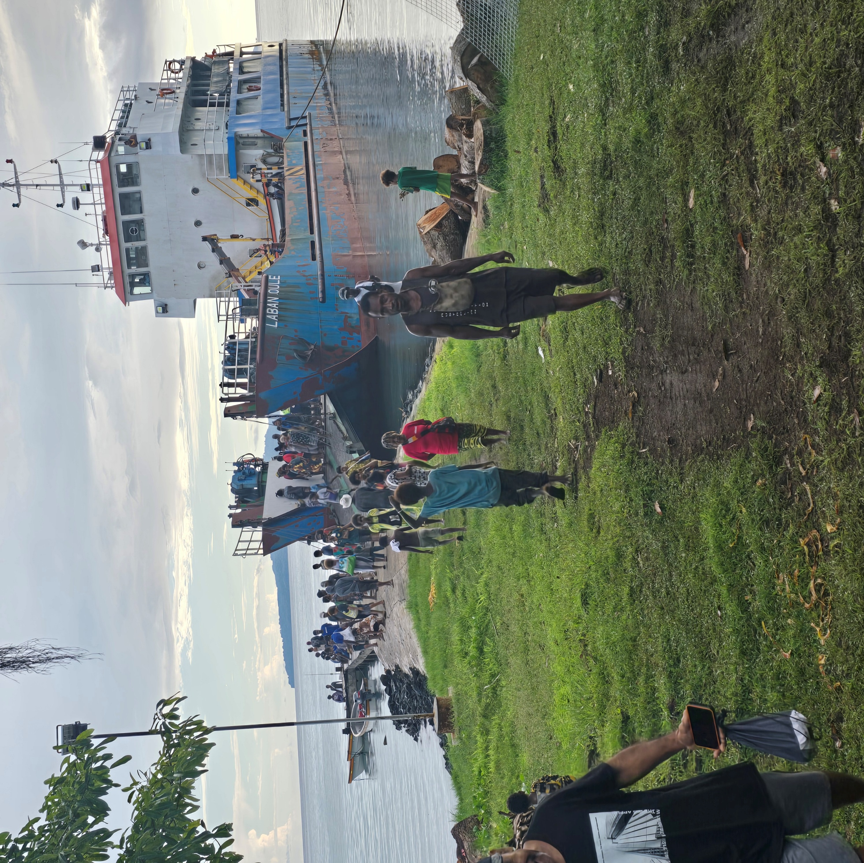
Challenges and Lessons Learned from the Baluan Project
Logistical challenges in managing remote island installation.
  Requirement to transfer >15 ton of materials and equipment's from Port Moresby to Manus, Manus to Baluan Island spanning >820km.
Community engagement critical for project acceptance and success.
Adapting technology to local conditions improves performance.
Collaboration with stake-holder's key to overcoming barriers.
Image courtesy of Sak Energy 2025
Image courtesy of Sak Energy 2025
Notes:
This slide highlights the socio-economic benefits derived from the Baluan Solar Breakthrough. Reliable electricity enables businesses to operate efficiently and schools to provide better learning environments. Healthcare facilities gain power for critical equipment, reducing dependence on diesel generators, which are costly and polluting. The project empowers the community toward sustainable energy independence and fosters overall social and environmental progress.

Slide 3
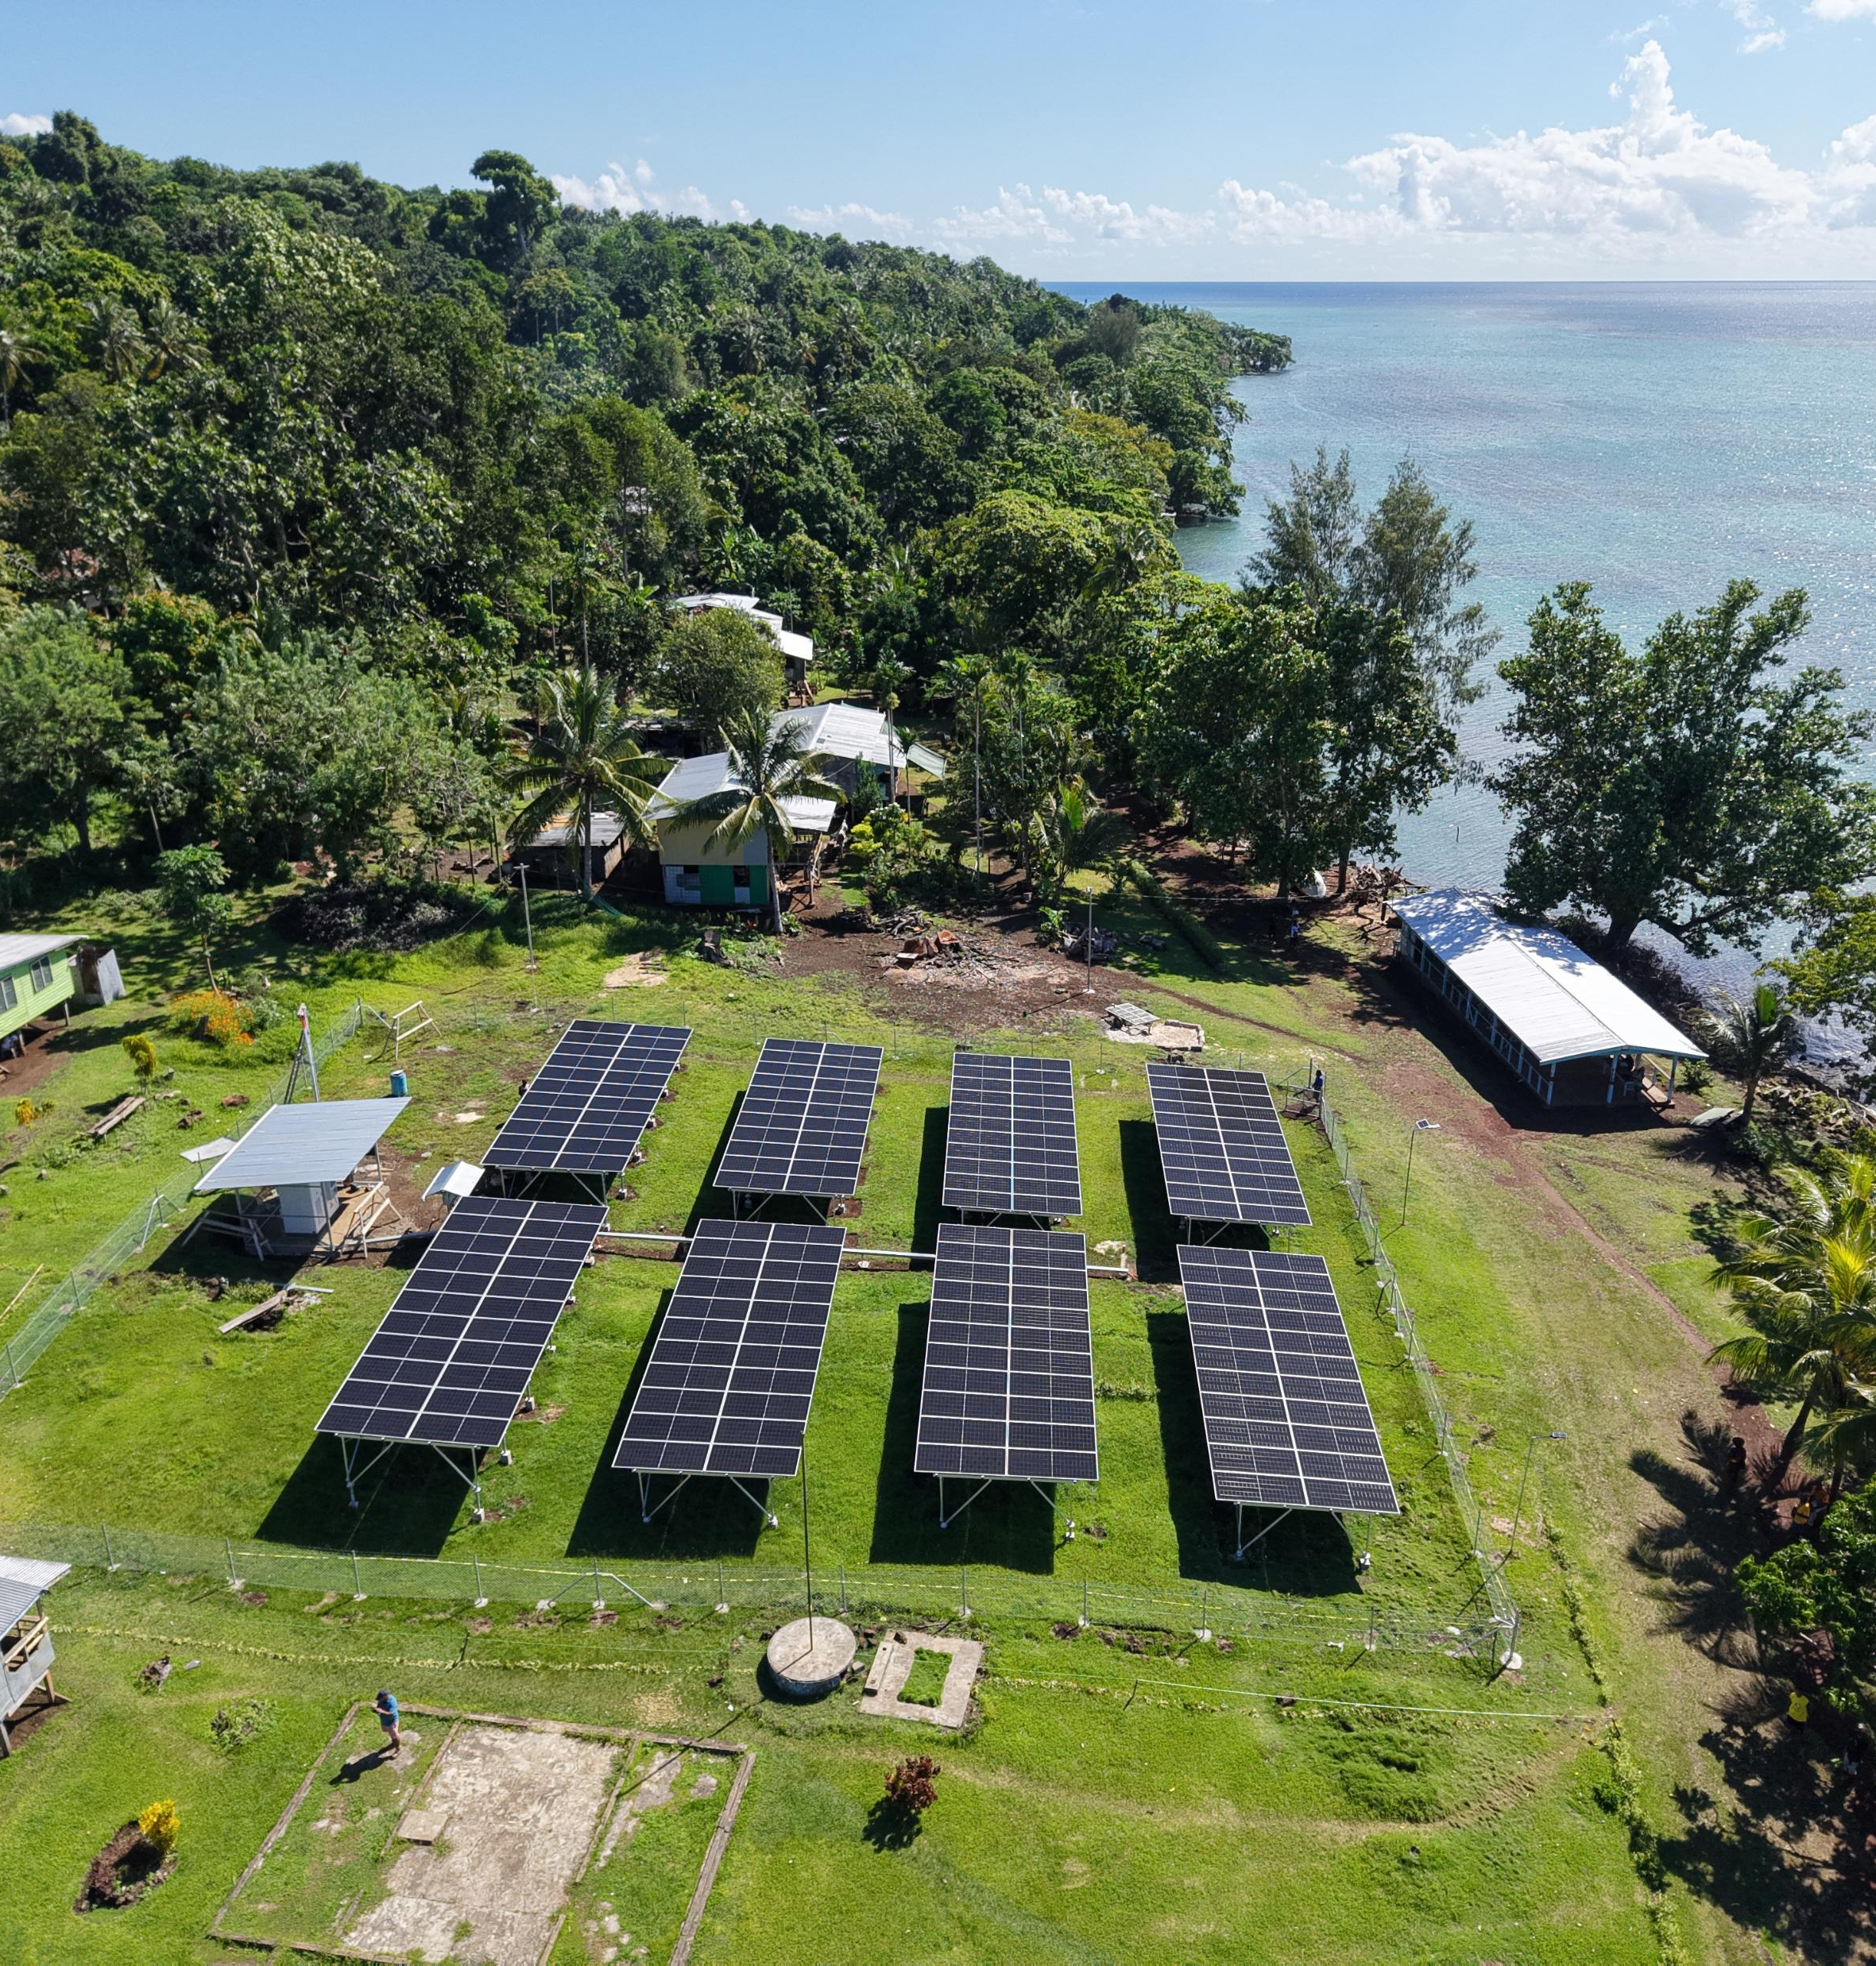
What We Offer
109kW solar PV array providing clean solar renewable energy
215kWh lithium-ion battery ensures 24/7 reliability.
Smart inverters and local operator training enhance system efficiency.
Clean power supply to adjacent Baluan Primary School to improve education quality.
Power supply to market facility to enhance local economic activities and boost cold storage supply chain for the island communities
Image courtesy of Sak Energy 2025
Image courtesy of Sak Energy 2025
Notes:
This slide discusses the challenges faced during the implementation of the Baluan Solar project, including logistical hurdles of installing equipment on a remote island and ensuring community buy-in. It underscores the importance of training local personnel for system maintenance and adapting technological solutions to local environmental conditions. Successful collaboration with various stakeholders helped overcome these challenges.

Slide 4
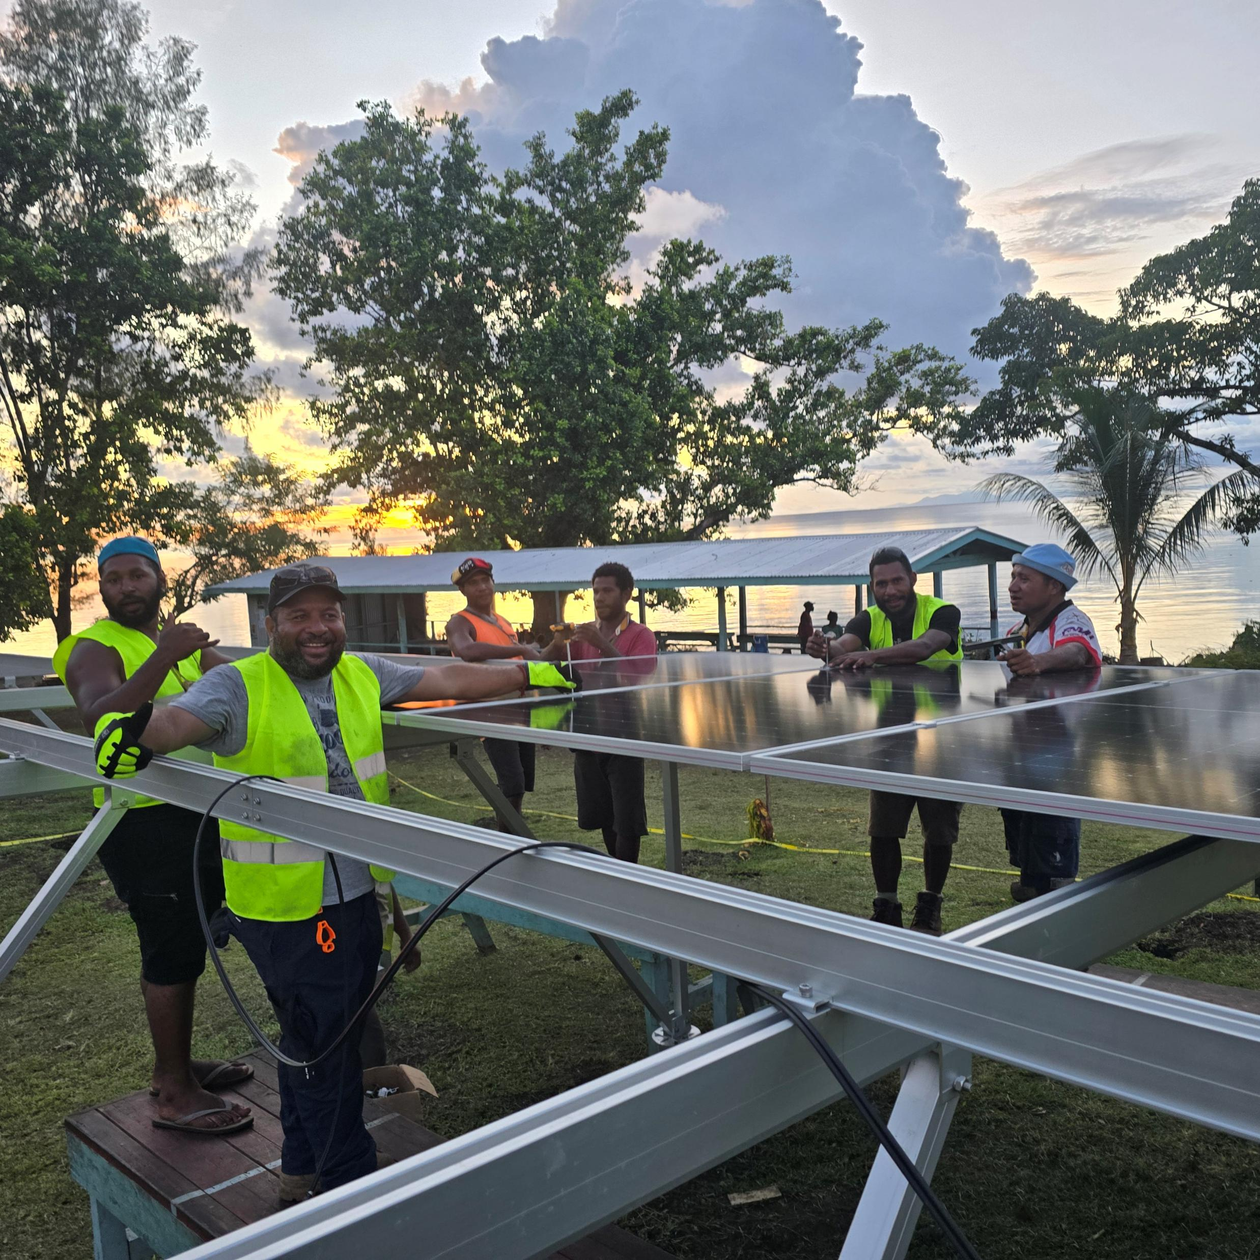
Implementation & Partnerships
Project funded by National Energy Authority (NEA) through Public Investment Funding from National Government of Papua New Guinea.
Collaboration with Baluan Development Association (BDA) to provide local support, landowner and community engagement.
Installation by SAK ENERGY SOLAR PAWA, a licensed contractor for NEA.
Trained local operators for ongoing system operations & management
Completed installation and commissioning successfully
Photo taken in Baluan Island by Sak Energy 2025
Image courtesy of Sak Energy 2025
Notes:
This slide highlights the socio-economic benefits derived from the Baluan Solar Breakthrough. Reliable electricity enables businesses to operate efficiently and schools to provide better learning environments. Healthcare facilities gain power for critical equipment, reducing dependence on diesel generators, which are costly and polluting. The project empowers the community toward sustainable energy independence and fosters overall social and environmental progress.

Slide 5

Impact on Baluan Island Community and Economy
Reliable electricity supports local businesses and education.
Improves health outcomes through powered medical facilities.
Reduces reliance on costly and polluting diesel generators.
Empowers community with sustainable energy independence.
Fosters social development and environmental stewardship.
Image courtesy of Sak Energy 2025
Notes:
This slide highlights the socio-economic benefits derived from the Baluan Solar Breakthrough. Reliable electricity enables businesses to operate efficiently and schools to provide better learning environments. Healthcare facilities gain power for critical equipment, reducing dependence on diesel generators, which are costly and polluting. The project empowers the community toward sustainable energy independence and fosters overall social and environmental progress.

Slide 6
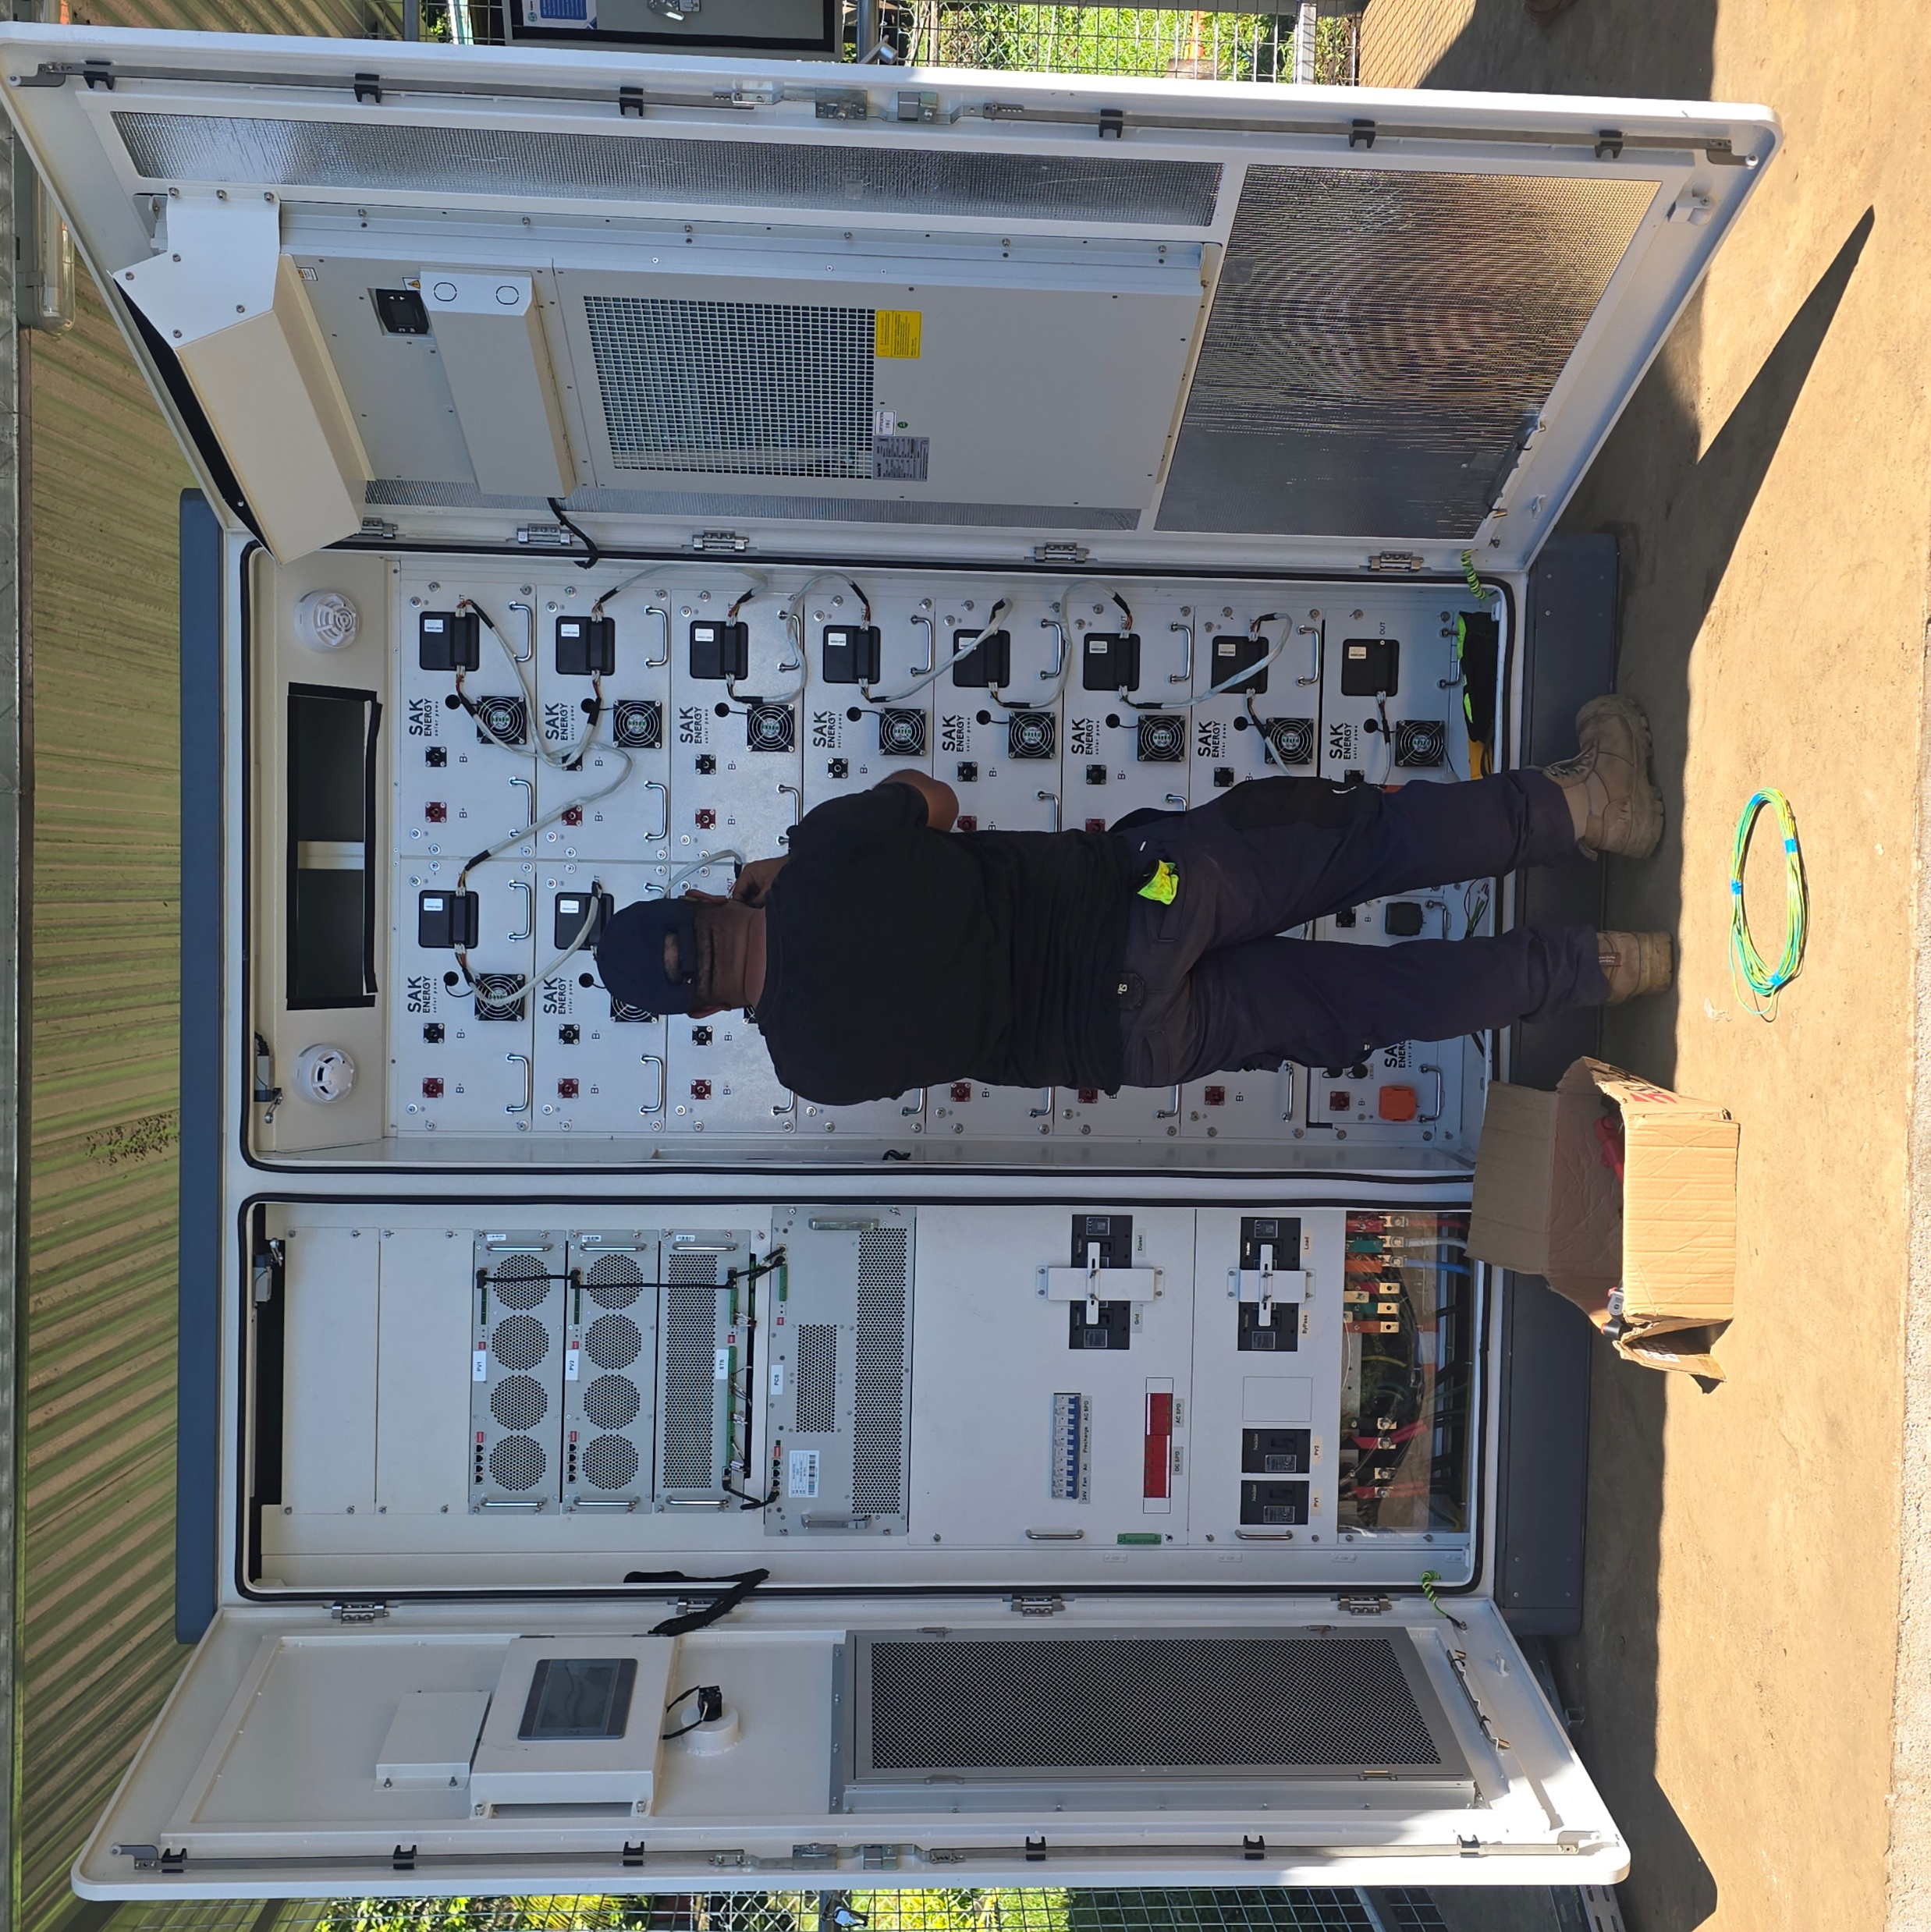
Scaling the Baluan Model Across PNG
Model adaptable for diverse rural and island communities. There are more than 6,000 sites across PNG.
Potential to accelerate PNG’s energy & electricity access targets of 70% electrification by 2030.
Encourages investment in renewable energy infrastructure in rural community.
Government and private sector partnerships vital for expansion.
Promotes replication of sustainable and resilient energy systems.
Image courtesy of Sak Energy 2025
Image courtesy of Sak Energy 2025
Notes:
This slide highlights the socio-economic benefits derived from the Baluan Solar Breakthrough. Reliable electricity enables businesses to operate efficiently and schools to provide better learning environments. Healthcare facilities gain power for critical equipment, reducing dependence on diesel generators, which are costly and polluting. The project empowers the community toward sustainable energy independence and fosters overall social and environmental progress.

Slide 7

Lookahead & Opportunities
Dozens of rural PNG sites scoped and ready for solar installation.
Proven model reduces cost per kW and speeds rollout
Collaboration with NEA and DDA’s to meet ESG or climate change targets for organization.
Join the mission to light up PNG’s rural future
Next Phase rollout of 100kW/215kWh
  Salamo Station, Esa’ala District, Milne Bay Pro
  Losuia Station, Kiriwina Island, Milne Bay Prov
  Magarida Station, Abau, Central Province
  Roma Station, Maprik, East Sepik
Image courtesy of Sak Energy 2025
Image courtesy of Sak Energy 2025
Notes:
This slide highlights the socio-economic benefits derived from the Baluan Solar Breakthrough. Reliable electricity enables businesses to operate efficiently and schools to provide better learning environments. Healthcare facilities gain power for critical equipment, reducing dependence on diesel generators, which are costly and polluting. The project empowers the community toward sustainable energy independence and fosters overall social and environmental progress.

