Slide 1
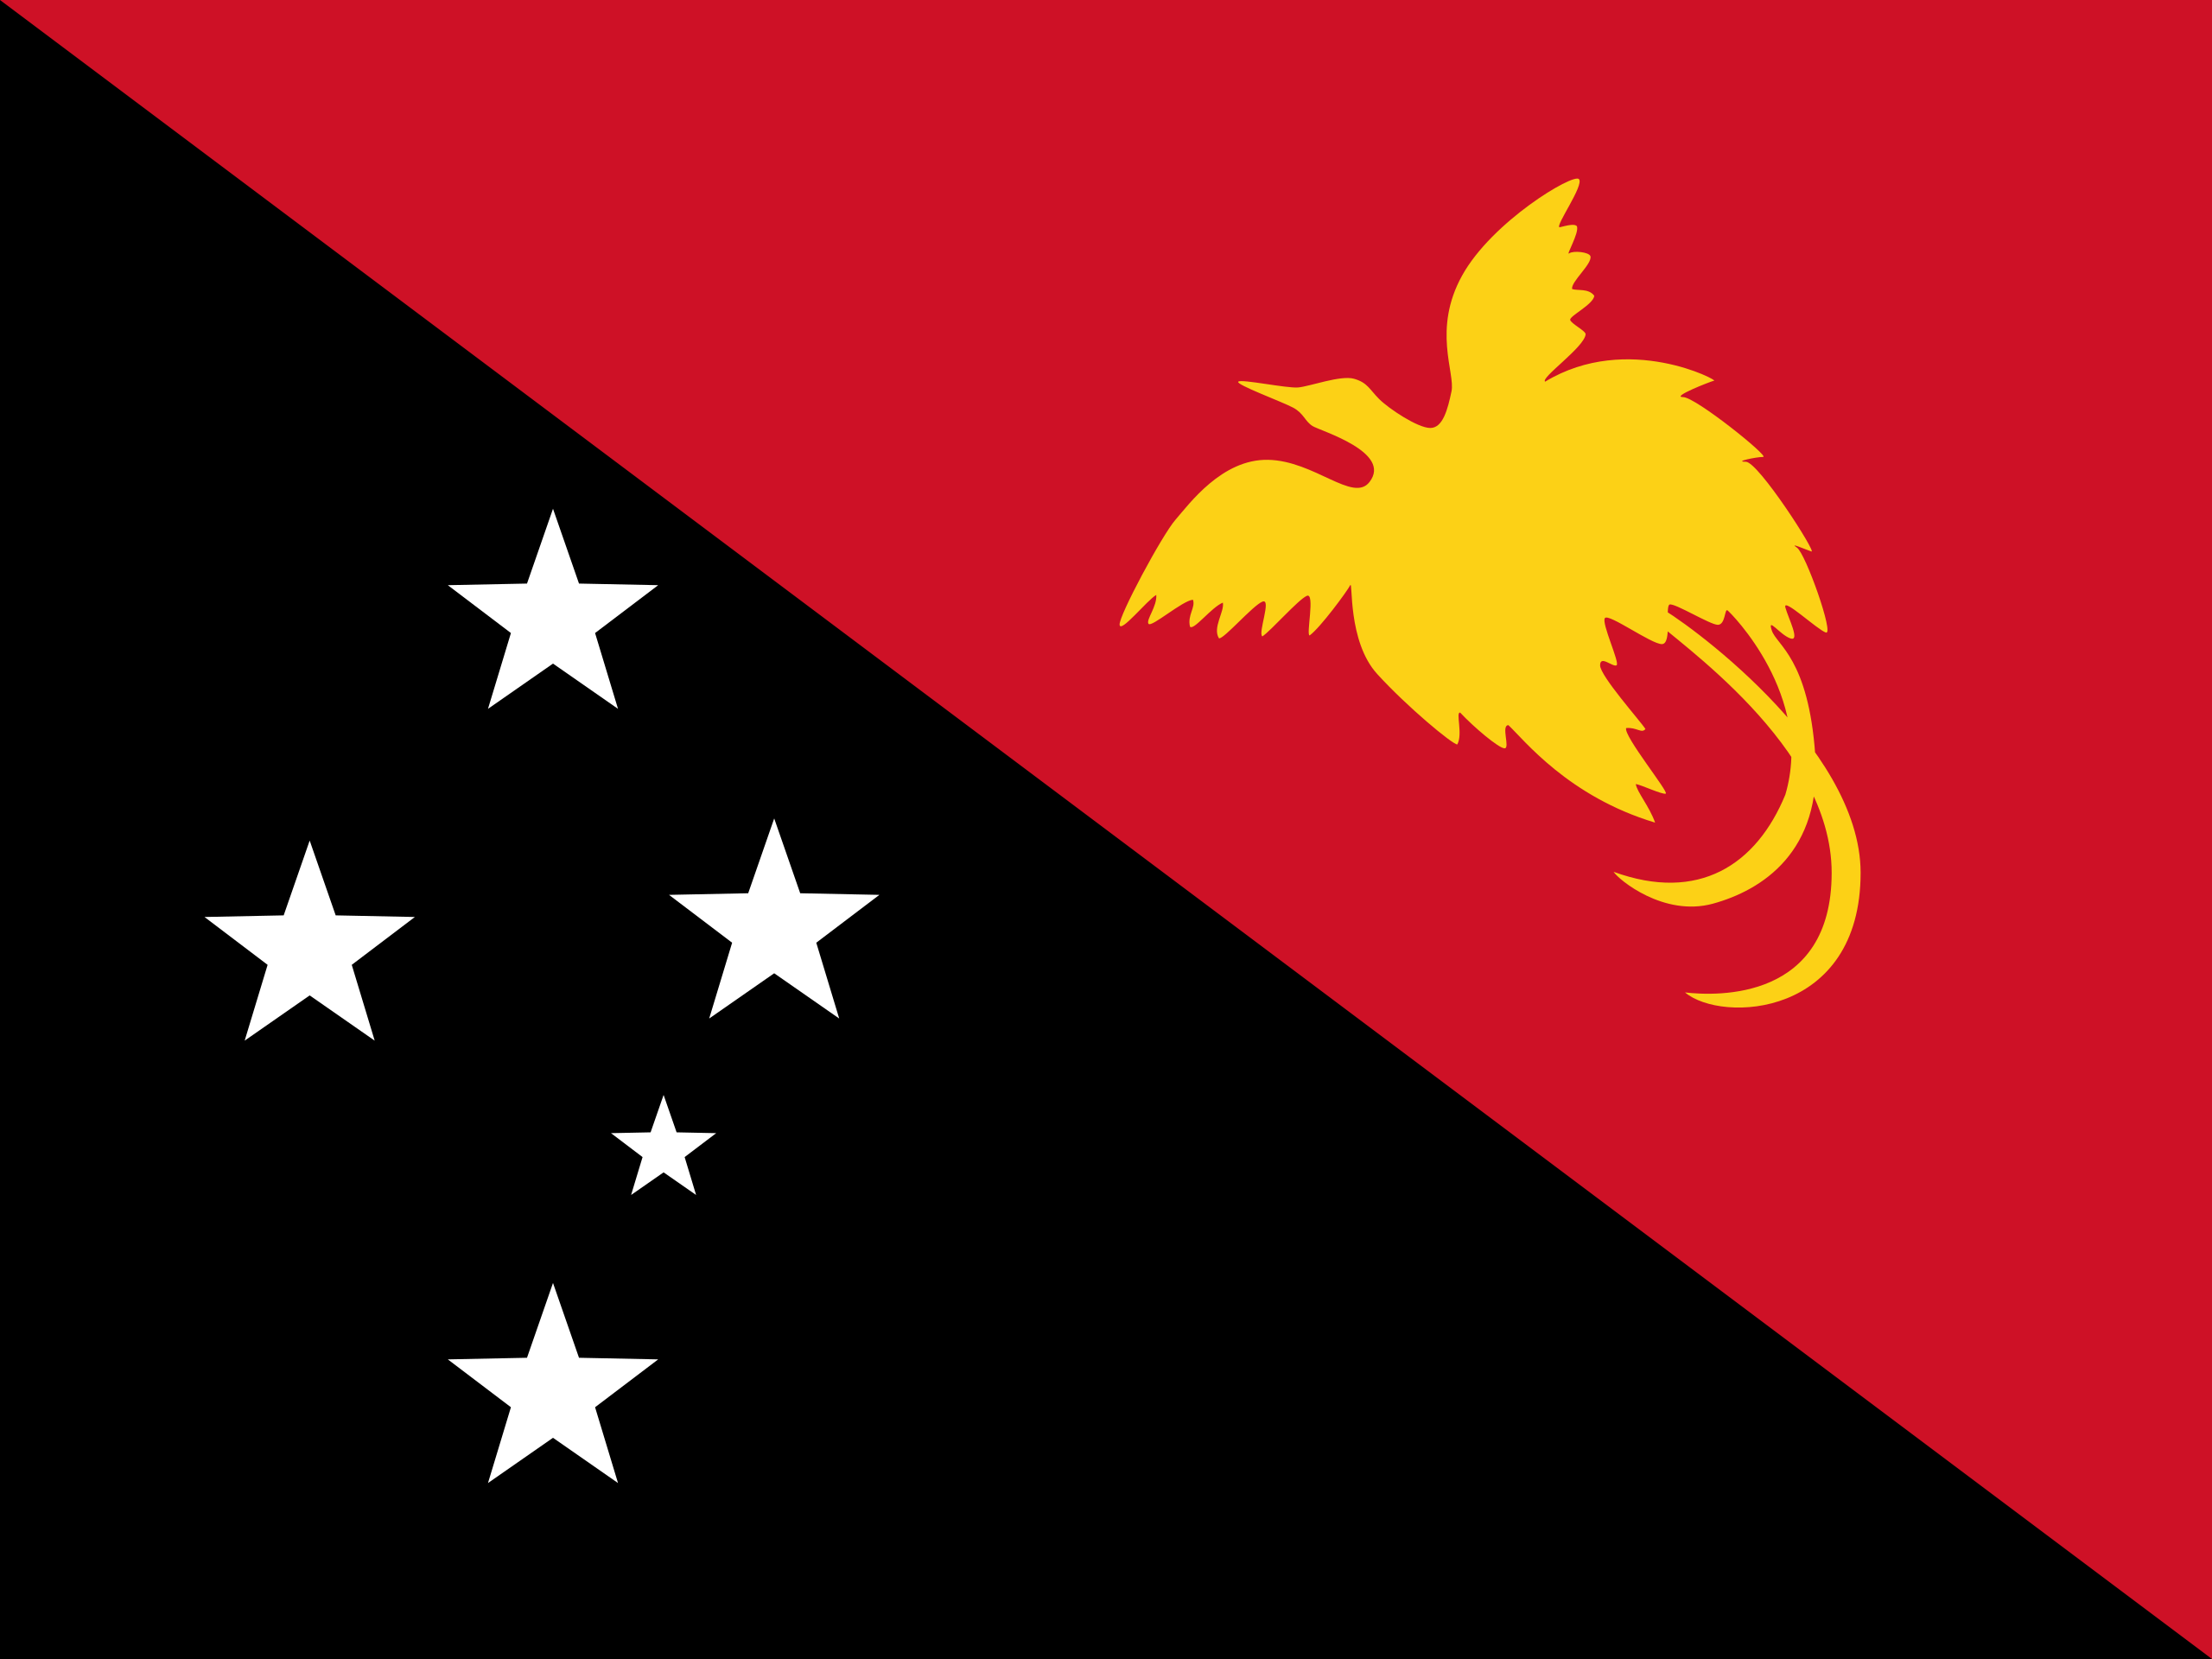
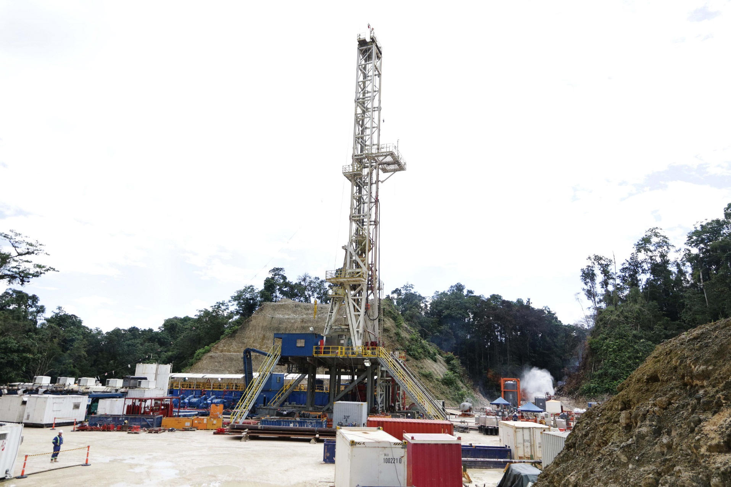
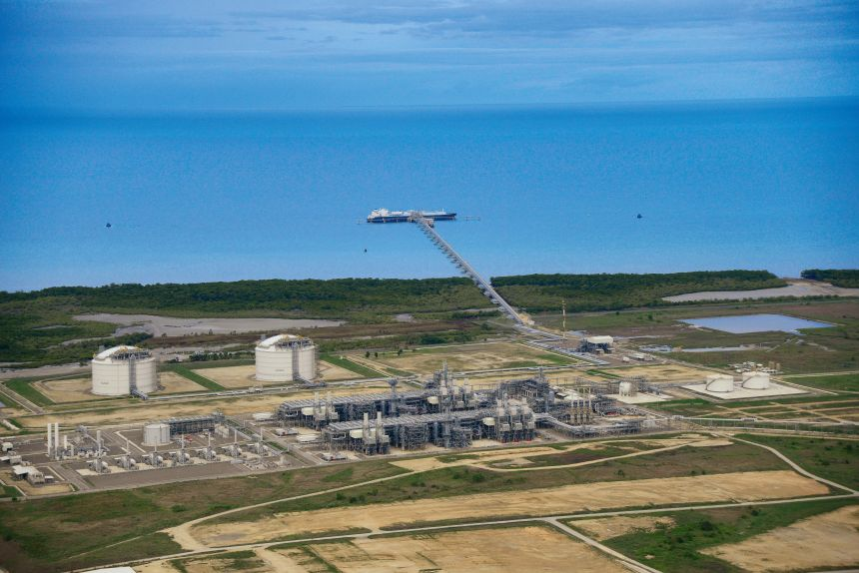

Western Province Development October 2025

Slide 2

Robinson Energy Limited
ROBCO was established in March 2022 to develop natural gas reserves in the Western Province of Papua New Guinea
ROBCO is led by J. Cameron Bailey who was previously the President and Chief Executive Officer of High Arctic Energy Services Inc. an energy service company providing drilling and related services in PNG.
Mr. Bailey background is in energy investment banking with a track record of raising over $15 billion of capital for energy development projects in Canada and throughout the world.

Slide 3
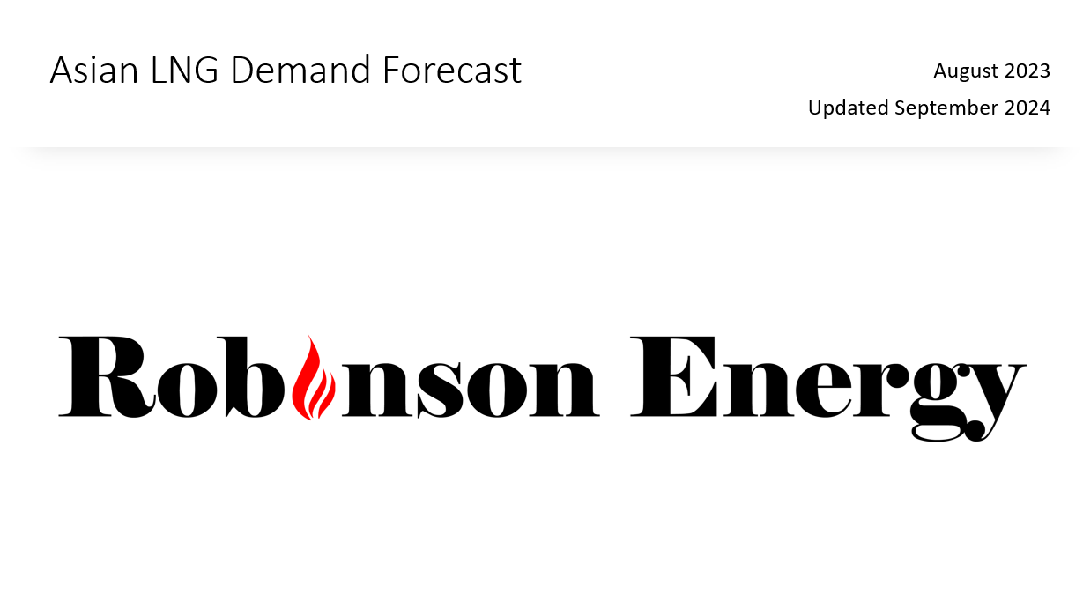
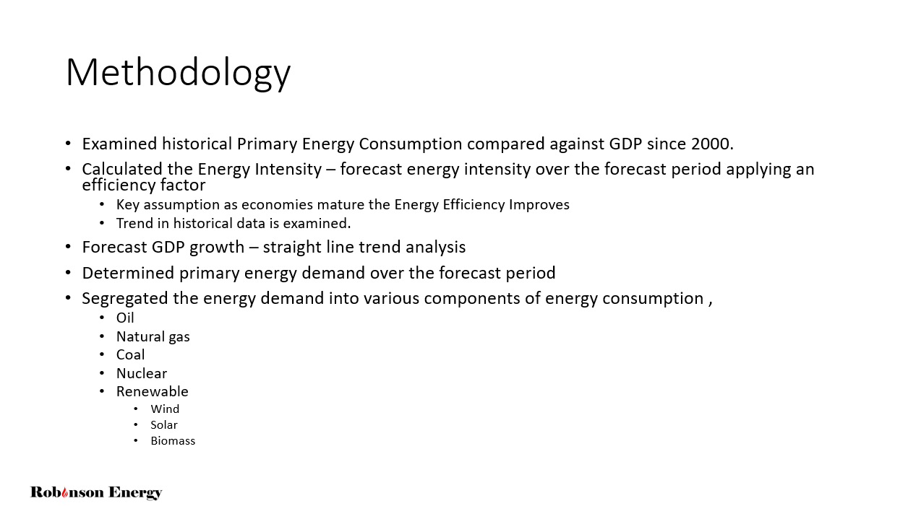
ROBCO Asian LNG Forecast Demand

Slide 4
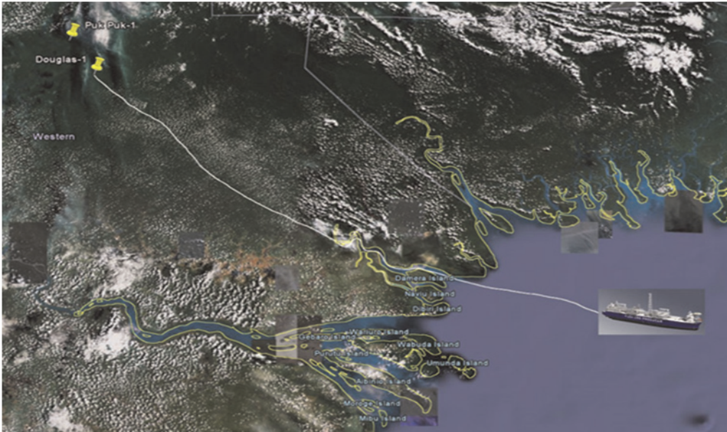
Following the discoveries of Douglas (2006) and PUK PUK (2009) Rift engaged FLEX LNG to develop a plan for floating offshore LNG facility.
Engaged OSD Pipelines (now Verbrec Evolution Engineering) to plot and optimal route for a pipeline and location of LNG facility.
Based on a reserve base of 750 bcf two options were considered: 1. 300mmcf/d – 1.5mmtpa
Gas flow rate of 300MMscfd which would supply one vessel producing approximately 1.5MTLNG/pa;
Estimated Costs of $700 and $770 million
Water depths of 30m
20” pipeline
2. 600mcf/d – 3.0mmtpa
Gas flow rate of 600MMscfd which would supply two vessels producing approximately 1.5MTLNG/pa;
Estimated Costs of $980 million
Water depths of 30m
26” pipeline
Rift was eventual acquired by Talisman in late 2009.
Rift Oil PLC -2008

Slide 5
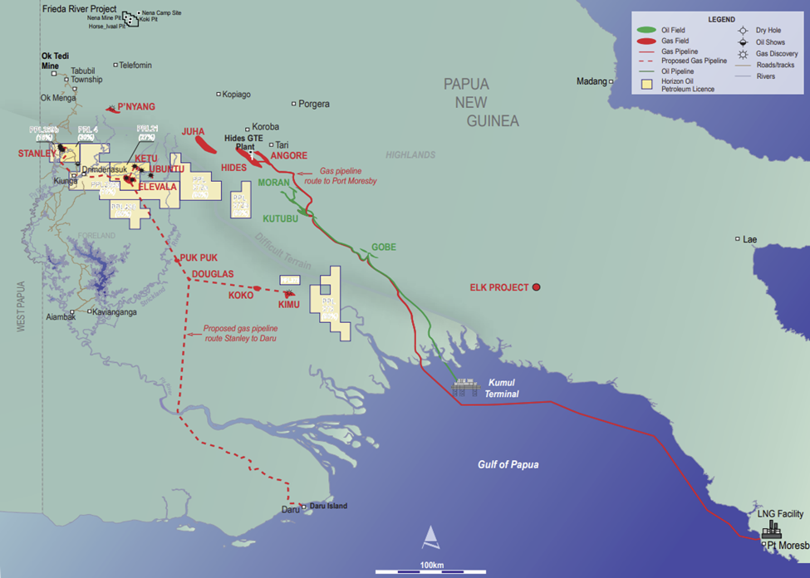
Horizon Oil/ Talisman Western Pipeline and LNG Proposal
Horizon Oil a junior oil and gas company listed on the ASX active in developing oil and gas reserves in New Zealand, China and Australia.
Horizon was active in Papua New Guinea from 2008 to 2020 when it sold its PNG portfolio of assets to Arran Energy.
Horizon and its partners which included Talisman assembled interests in various licences in the Western Province which had and estimated 2C Resource of 2.4 tcf.
In 2013 Horizon lodged an application for PDL 10 and associated pipeline licence for the development of a liquids recovery gas re-injection scheme at Stanley.
Following the successful drilling of Elevala-2 and Ketu-2 Horizon began the study of a liquids recovery/gas re-injection scheme at PRL 21 and began the planning for a Western Gas pipeline and LNG facility and lodged application for PDL 12 in 2014
Source – 2013 Horizon Annual Report

Slide 6
Horizon Oil/ Talisman Western Pipeline and LNG Proposal
In from 2013 to 2018 Horizon refined the evaluation of a pipeline and LNG facility based on total 2C reserves for the fields a summary is as follows:
PDL 10 - Stanley Field
PRL21 – Elevela, Ketu and Tingu Fields
PRL28 – Ubuntu Field
PRL40 – Puk Puk and Douglas Fields
Upstream processing facilities would initially be developed near Kiunga to gather production from Elevala, Ketu,Stanley and Ubuntu fields.
The Puk Puk, Douglas, Weimeng and Langia fields would be developed as back-fill through.
The proposal was a 500km onshore pipeline consisting of gas pipeline and condensate pipeline routed to liquification facility on Daru Island.
Estimated production was 290mmcf/d allowing for production of 1.8mtpa of LNG and 15,000 bbl of condensate with upstream field cost of $1.2 billion
Estimated pipeline costs consisting of 520km of 24” gas pipeline and 520km of 10” condensate pipeline was $1.0 billion.
The estimated cost of 1.8mmtpa floating LNG facility was $2.0 billion.
Total project cost of $3.3 billion
Based on a 2C case $74/boe JCC and LNG 12.5% of JCC prices of $9.25 per mmbtu the project would generate an estimated
Rate of Return of 13%
break- even price of $60/bbl being $7.50per mmbtu.

Slide 7
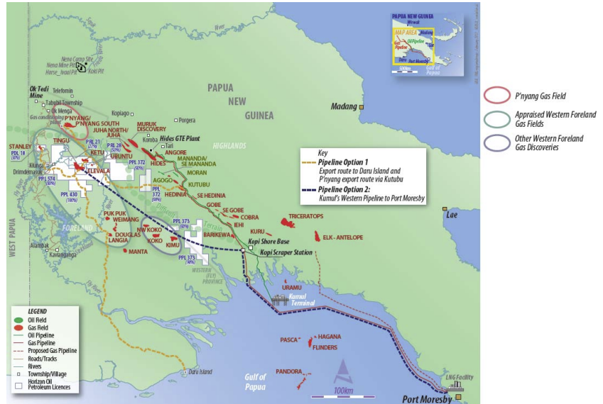
Alternative Western Province Pipeline
At the December 2016 PNG Mining and Petroleum Conference a KUMUL Petroleum development proposal was referenced through the aggregation of fields and providing transportation
The proposal involved a 400km pipeline from PRL 21 to KOPI and a further 400km to Caution Bay.
No estimated costs, pipeline capacities or tolling schemes were presented.
Source –February 2017 Horizon Presentation to PNG Petroleum and Energy Summit

Slide 8
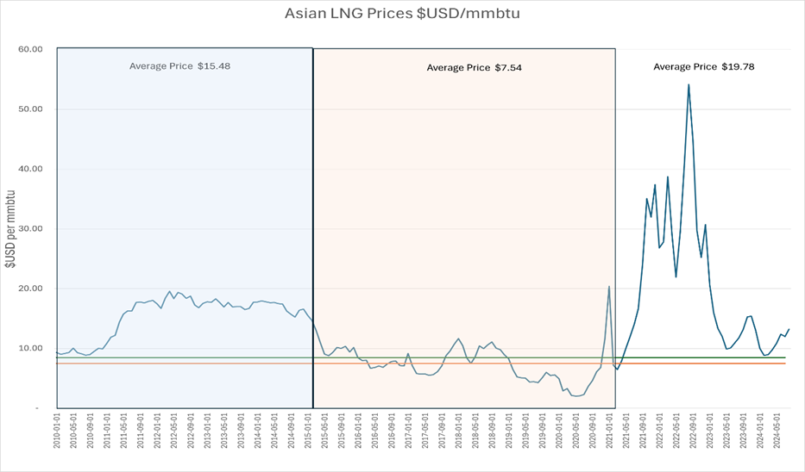
Historical Asian LNG Prices - JKM $USD/mmbtu
From the period of 2010 to 2014 the average Asian LNG prices amounted to $15.48 $USD per mmbtu.
This compares to an average of $USD 7.54 per mmbtu for the period from 2014 to 2020.
We have estimated the breakeven cost for generating a positive rate of return is between $7.50 and $8.50 per mmbtu.
We believe reasonable expectation for Asian LNG prices to maintain a range between $10.00 and $15.00 per mmbtu providing ample returns for a proposed Western Province Gas Development.

Slide 9
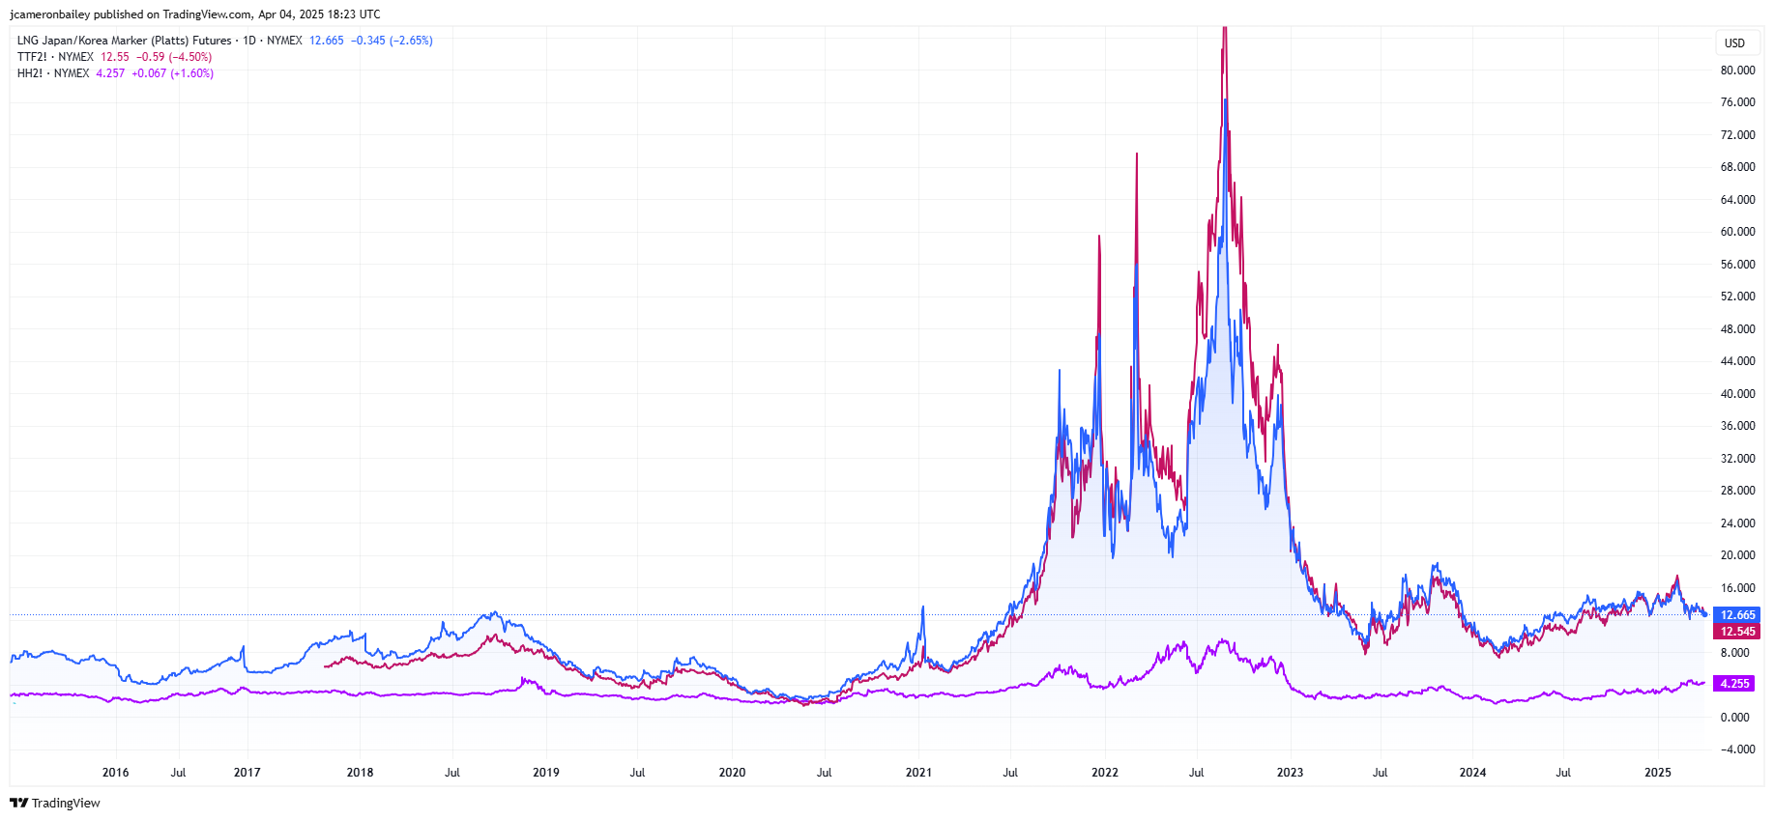
Asian LNG Prices $USD/mmbu
Henry Hub
JKM
TTF
Japanese Korea Marker (JKM) – proxy for Asian LNG Spot Price
Economic modeling based on $10 per mmbtu

Slide 10
Petroleum Resource Industry
Alberta - Canada
PNG Development
Pipeline/Midstream represents $1T of value being approximately 1/2 of the entire $2T Petroleum Industry

Slide 11
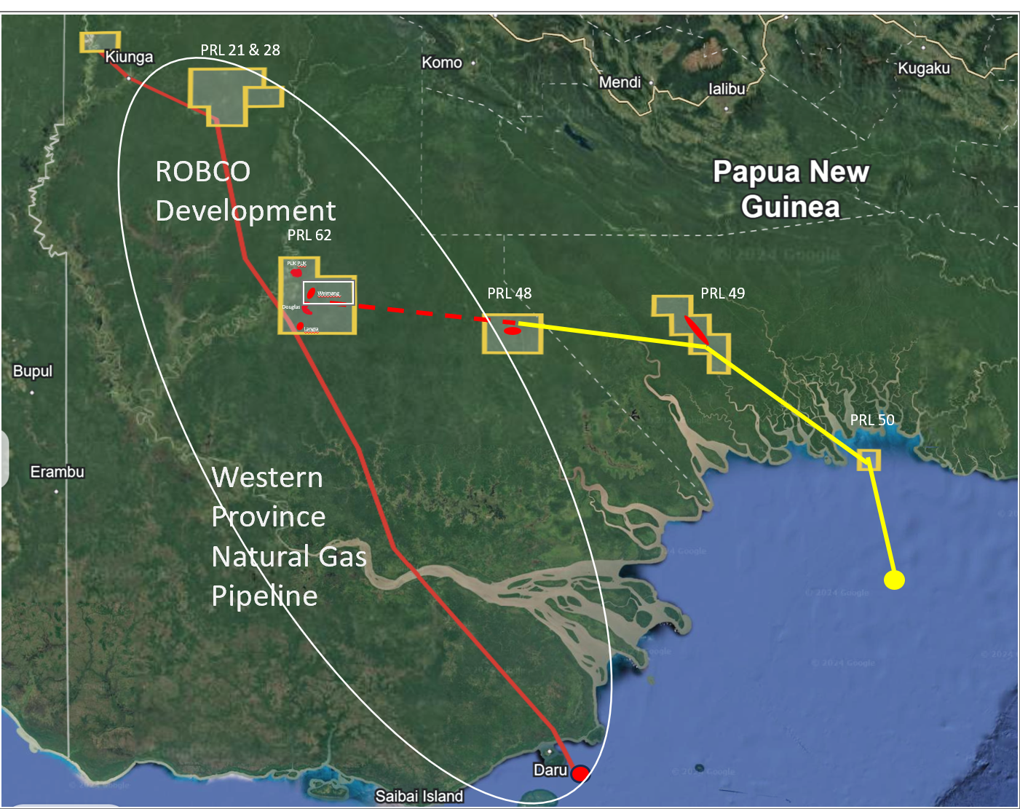
4.6 tcf of Resource
31 Wells
>500mmcf/d

Slide 12
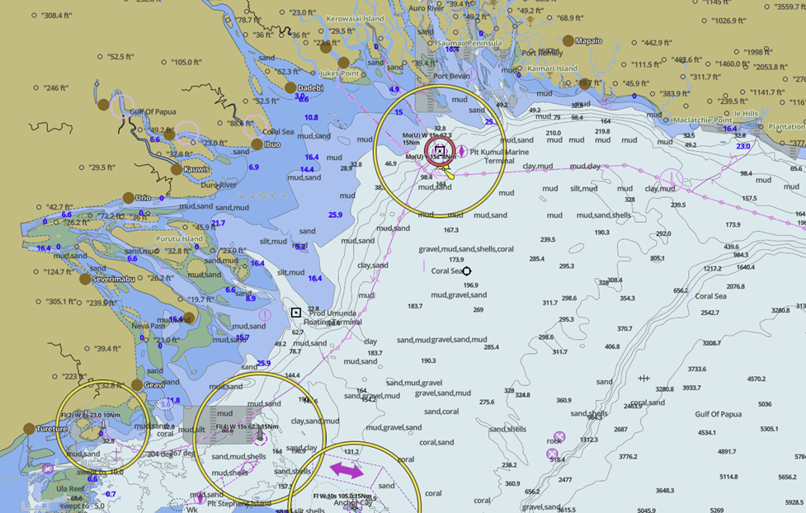
LNG Facility Location – Water Depths
The following map indicates the minimum water depth required for a LNG carrier to navigate in the Gulf of Papua outlined in light blue indicating
The Kumul Terminal is located 40km to the closest point onshore.
The first option for the location of LNG Facility would be a floating facility in the Gulf of Papua located near the Kumul Marine Terminal which would have very similar pipeline distances as the second option of locating offshore Daru Island.

Slide 13
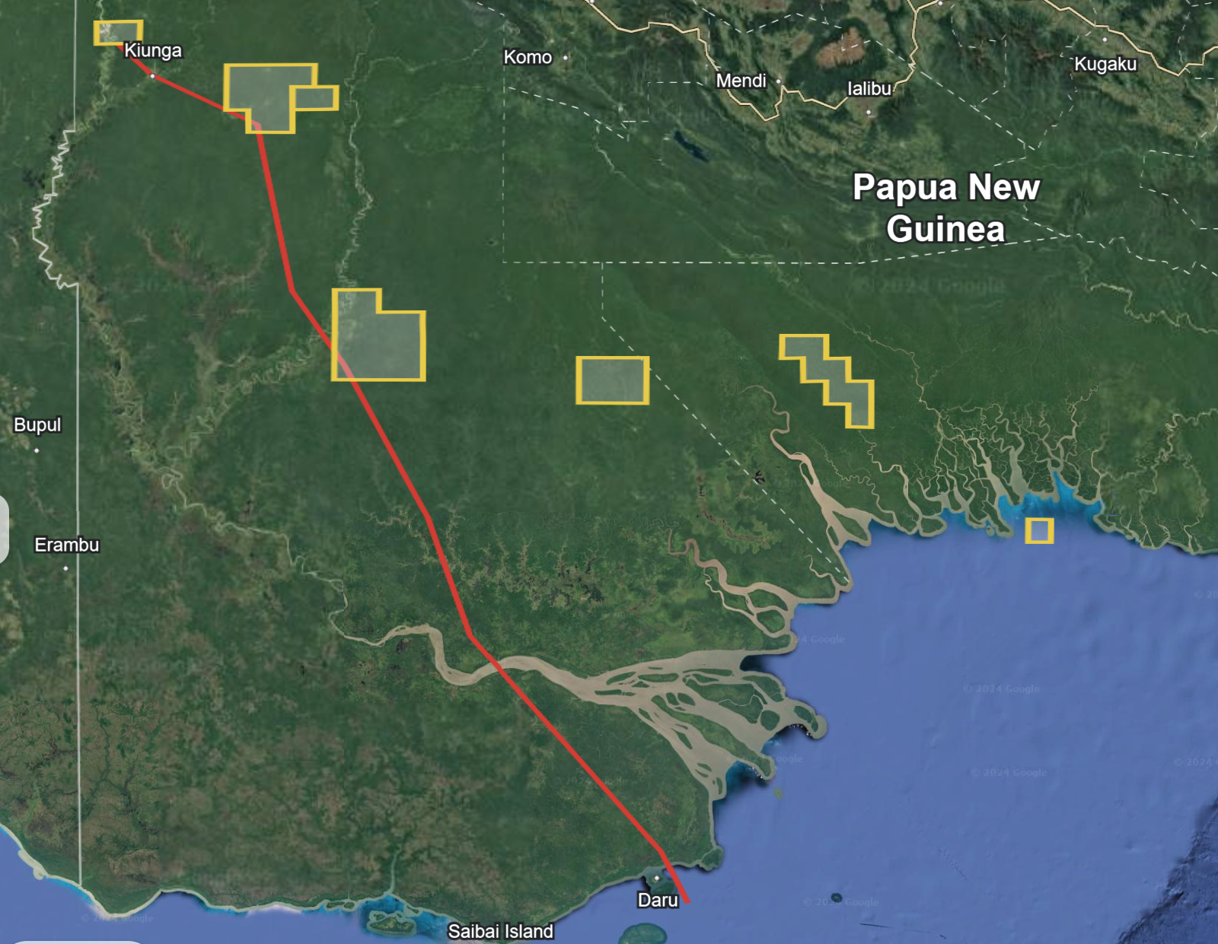

Western Province Commercialization
PRL 21 & 28
KUMUL Proposed Development
1.5mtpa Floating LNG Facility located at Kumul Terminal
360 km of Pipeline
$3.5 - $5.0 billion
Contracted Wison Innovation to complete a FEED study
Natural Gas supply is sourced from 100% owned Kumul Licences PRL 47, 48, 49 and 50
Pandora - 800 bcf
Kimu - 507 bcf
Barikewa – 676 bcf
Uramu - 234 bcf
Total Resource – 2.2 tcf
PRL 62
PUK PUK
Weimang
PRL 48
PRL 49
Douglas
Langia
PRL 50
Western Province Natural Gas Pipeline
Kumul Terminal
PRL 47

Slide 14
Western Province Commercialization
PRL 21 & 28
Western Province Natural Gas Pipeline
Renewal of the Talisman/Horizon Western Province commercialization plan
480km 26” Natural Gas Pipeline and 8” condensate Pipeline - $1.7 billion
Floating 3.8mtpa LNG Facility at Daru – $4.1 billion
ROBCO has entered into a MOU with a Korean Asset Manager to provide $4.5 billion is infrastructure financing for the construction of the pipeline and LNG facility.
ROBCO was issued PRL 62 in March 2025 providing the foundation of the development in the Western Province.
PRL 62
PUK PUK
Weimang
PRL 48
PRL 49
Douglas
Langia
PRL 50
Western Province Natural Gas Pipeline

Slide 15
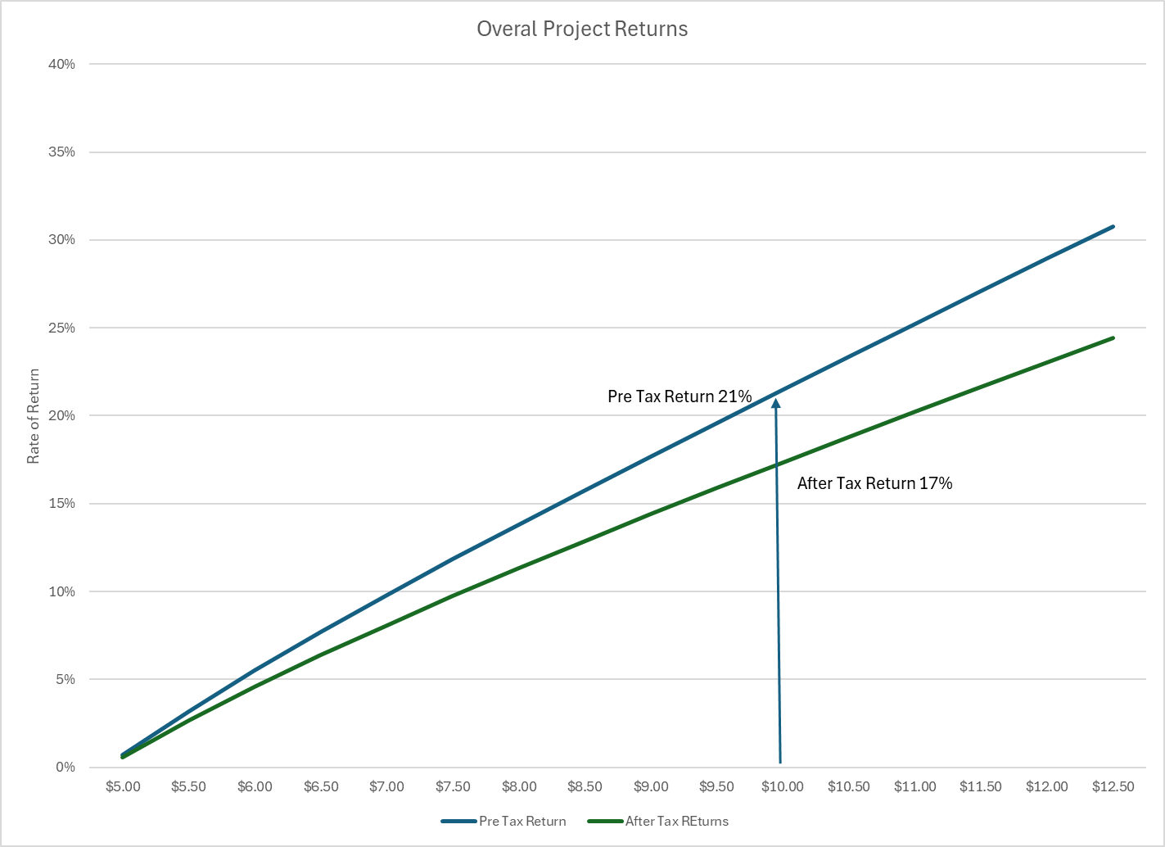
Western Province Pipeline and LNG Facility

Slide 16
Western Province LNG Facility
Based on field production of 500 mmcf/d the annual LNG production would be 3.8mtpa. Annual declines match those of the aggregate feedstock.
The project rate of return on the LNG facility component of the project is 16.7%.
Assuming new sources of natural gas are discovered in the Western Province and tied into the Western Pipeline and throughput at the plant capacity remains constant at 500 mmcf/d the rate of return from the LNG facility increases to 21.4%
The average tolls for US based LNG facilities are facilities are $2.45 per mcf.
Key Assumption
Reserves 2.4 tcf
PDL 10
PRL 21
PRL 28
PRL 62
Structures 10

Slide 17
Western Province Pipeline and Proposed Tolling Scheme
The estimated pipeline distance to service PRL 40, PRL 21 & 28 and Stanley are approximately 463 km with approximately 70km offshore and 393km onshore based on the routing outline below.
The Western Province Gas Pipeline proposed in a 26” natural gas pipeline and a 10” condensate extending from Stanley to Daru estimated to extend approximately 477 km.
Estimated cost is $1.7 billion being $3.6 million per km.
Based on 500 mmcf/d from the three areas, and the Tolling Scheme proposed, the Rate of Return on the Pipeline would amount to a modest 14.3%.

Slide 18
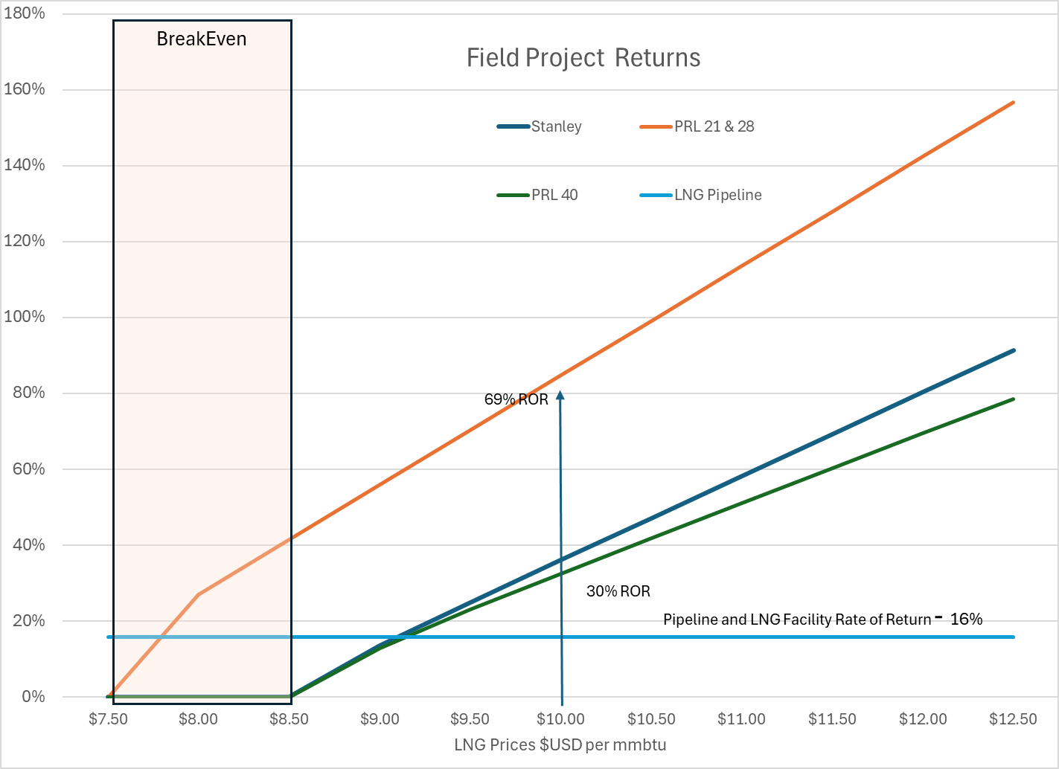
Field Development
Based on the estimated field development cost and the associated Tolls related to the location of each field we can calculated the Rate of Return from each unique field development

Slide 19
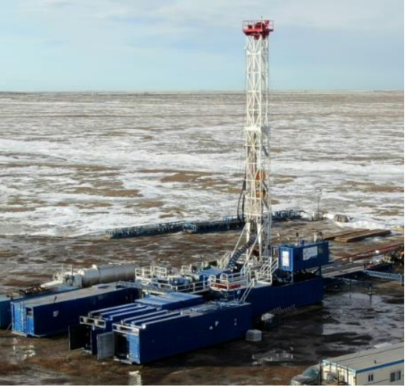

High Arctic Rig 115 - Barikewa
Star Valley Drilling - Rig 102
Well Depth 1,950m
Men on Location 125
Days on Location 55
Well Cost $30mm
Well Depth 2,374m
Men on Location 6
Days on Location 8.6
Well Cost <$1.0mm

Slide 20
Multi Disciplined Approach to Western Province Development
Coordination and cooperation amongst Licence holders to ensure sufficient critical mass to justify the construction of a Pipeline and LNG Facility.
Strategy to reduce execution cost in the Western Province – Land Access
Access to capital focus on Strategic Pipeline and LNG Facility servicing multiple resource owners/developers segregating risk/return profile of various components of development

Slide 21
Benefits of Western Province Pipeline and LNG Facility
Estimated of 300 km of roads required to be constructed to access well locations
500 km road building along pipeline construction route connecting Western province from Daru to Kiunga
Opportunity for Natural Gas Generated Electricity to supply rural communities and other commercial developments.
Estimated Government proceeds of over $5 billion in taxes and royalty receipts over the life of the project.
Stimulate exploration and development activities in the Western Province – promote long term support from local services and employment.

Slide 22
Papua New Guinea J. Cameron Bailey jcbailey@robinsonenergy.ca 403 680 0434 www.robinson-energy.com

