Slide 1
The FATF Standards
&
PNGs Mutual Evaluation Report (MER) 2024
Presentation by:
Wilson Onea
Director- Financial Analysis & Supervision Unit (FASU)
Bank of Papua New Guinea

Slide 2
Objectives
PNG’s Mutual Evaluation Report (MER)
PNG’s MER: Key Findings
Actions Required of PNG
FATF grey-list Impacts

Slide 3
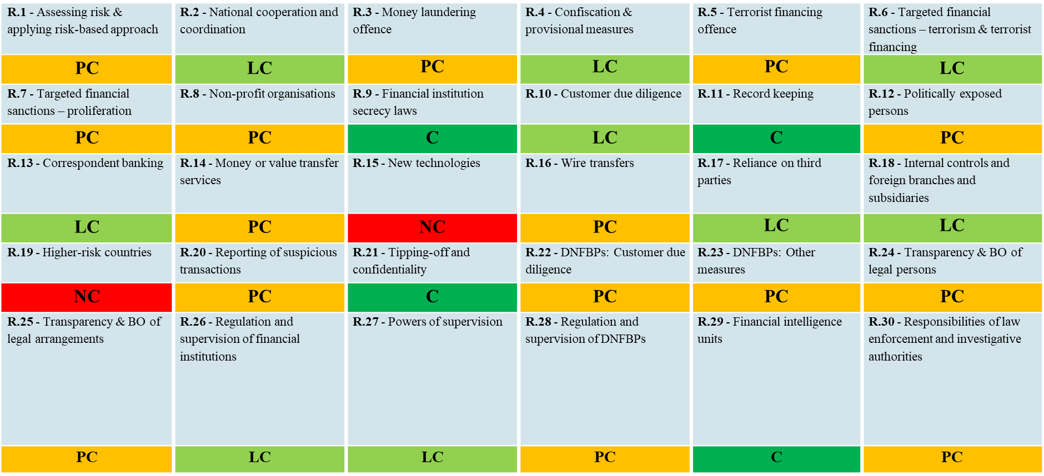
Technical Compliance Ratings

Slide 4
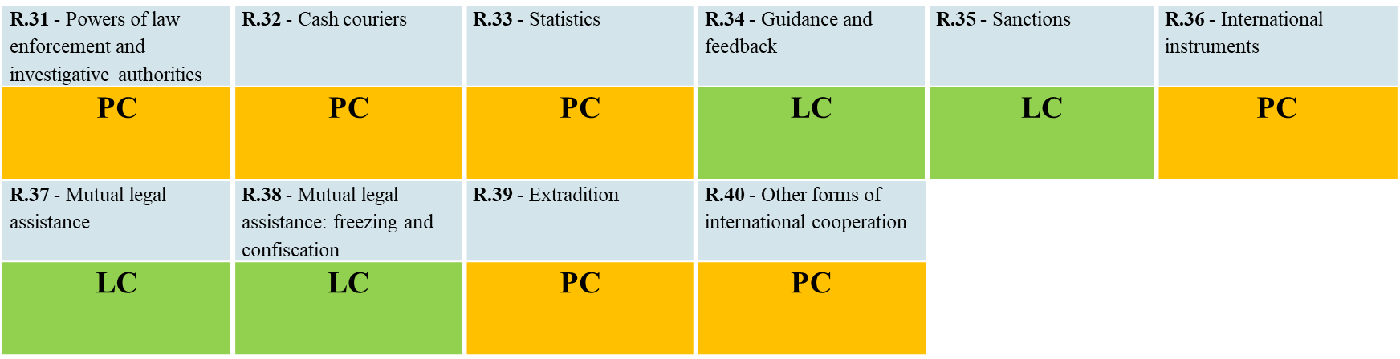
Ratings Summary:
4 Compliant (C)
13 Largely Compliant (LC)
21 Partially Complaint (PC)
2 Non-Compliant (PC)

Slide 5
Effectiveness Ratings:
Immediate Outcomes (IOs).
IO.1 - Risk, policy and coordination | IO.2 - International cooperation | IO.3 - Supervision | IO.4 - Preventive measures | IO.5 - Legal persons and arrangements | IO.6 - Financial intelligence
Moderate | Moderate | Moderate | Moderate | Low | Moderate
IO.7 - ML investigation & prosecution | IO.8 - Confiscation | IO.9 - TF investigation & prosecution | IO.10 - TF preventive measures & financial sanctions | IO.11 - PF financial sanctions
Low | Low | Low | Moderate | Low
Rating Summary;
6 Moderate; and
5 Lows

Slide 6
KEY FINDINGS (2/10)
Key ML threats related to PNG’s significant ML risk are: (i) corruption and bribery, (ii) fraud against government programs and activities, (iii) illegal logging and fishing, and (iv) tax offending. Skills, capacity and institutional resources for AML/CFT activities targeting these threats is a key challenge. Resource constraints are most acute for law enforcement.
PNG has undertaken one ML/TF NRA, three sectoral assessments and an update to the NRA is ongoing. Mechanisms are in place for AML/CFT policy on operational cooperation with policy-level coordination. Operational cooperation and coordination on ML and asset confiscation is limited.

Slide 7
KEY FINDINGS (4/10)
FASU is a well-established FIU. Overall use of financial intelligence by relevant competent authorities to develop evidence and trace criminal proceeds related to ML and high-risk predicate offences is very limited.
PNG is not prioritising or pursuing ML and asset recovery in line with its ML risks. The RPNGC, the OPP, and other relevant competent authorities all lack skill capacity and institutional resources for, and prioritisation of, their ML and asset confiscation functions and are not achieving operational outcomes commensurate with PNG’s significant ML risk.

Slide 8
KEY FINDINGS (6/10)
The Independent Commission Against Corruption was formed in July 2023 and at the time of the ME onsite visit had not commenced operational activities and was not fully integrated into PNG’s AML regime and PNG’s national AML/CTF policy.
PNG is not a high-risk jurisdiction for terrorism or TF. No investigations, prosecutions or convictions for TF in PNG. PNG’s ability to identify TF is limited to FASU’s intelligence. Relevant competent authorities lack skilled capacity and formal CFT policies and manuals to identify, investigate, and/or prosecute potential TF activities should they arise.

Slide 9
KEY FINDINGS (7/10)
PNG’s legal framework to implement targeted financial sanctions for TF and PF has minor and moderate shortcomings, respectively.
Authorities do not have a strong understanding of targeted financial sanctions. Minimal cooperation between the relevant competent authorities.
Screening practices vary widely across FIs and DNFBPs. No funds have been frozen for TF or PF, which is consistent with PNG’s risk profile.

Slide 10
KEY FINDINGS (8/10)
FASU is the sole AML/CTF supervisor with its supervisory actions focused on the commercial banking sector, which is PNG’s most vulnerable sector. FI and DNFBP regulators need to prioritise implementation of fit and proper controls.
More Onsite and/or offsite inspections required for all reporting sectors.
More compliance efforts need demonstrating.

Slide 11
KEY FINDINGS (9/10)
The Registrar of Companies is focusing its resources on a re-registration process for all companies. The registrar is empowered to obtain BO information held by companies. IPA to improve BO requirements by way of amendments to laws/regulations for BP information to be available.

Slide 12
KEY FINDINGS (10/10)
PNG is not seeking formal international cooperation at a level fully consistent with its significant ML and predicate crime risks and prevalence of laundering abroad. All relevant competent authorities mainly use their established cooperation mechanisms to respond to requests, rather than to pursue criminals and their assets abroad.

Slide 13
What Next?
What must PNG do now? Action the 75 recommended action items contained in the MER by;
Enacting new laws & amending existing laws to address gaps identified by the MER’s Technical Compliance (TC) ratings.
Increase supervision and enforce regulatory compliance activities for money laundering (ML), terrorist financing (TF) and proliferation financing (PF).
Increase investigations and prosecutions for ML/TF & PF.
Increase seizing and confiscating of assets generated by financially motivated crime including corruption and terrorism.
These action items require adequate funding and resources (2026-2030).

Slide 14
FATF - GREY-LISTING
As of October 2024, ICRG has reviewed 137 countries and jurisdictions and publicly identified 112 of them. 27 countries are currently under ICRG review.
Of these, 85 have since made the necessary reforms to address their AML/CFT weaknesses and have been removed from the process.
27

Slide 15
FATF - GREY-LISTING IMPACTs
ICRG review leads to economic impacts (loss of capital inflows, FDI, other investments)
Increased customer due diligence checks/cost of compliance
Loss of corresponding banking relationships/loss of faith
Payment delays influence on supply chains & trade
Downgrading of sovereign credit & business ratings
Restricting in nesting & down streaming correspondent financial links
Difficulties in remitting funds to sustain foreign missions
FATF annual report 2014-2015, described the naming of non-compliant countries as a "powerful tool" that "puts pressure on the countries in question to address these deficiencies in order to maintain their position in the global economy.
30

Slide 16
Fighting Financial Crimes
is
Everyone’s Business.

