Slide 1

ADVANCING TECHNOLOGY DRIVING EFFICIENCY AND GROWTH

Slide 2

PRESENTATION OUTLINE
The Vision
Policy Interventions
Policy and Structural Reforms
Technology Adoption Approach
Phase 1: SevisPortal
Phase 2: SevisPass (Digital ID)

Slide 3
THE VISION
Improve Operational Efficiency
Foster Innovation
Increase Government Revenue
Transform User Experience
‘Digital transformation that makes government more effective, improves service delivery, and fosters inclusive social and economic development because of a smart, networked and well-informed society’

Slide 4

2022
Structural Reforms
National Budget Alignment
National Cyber Security Centre deployed
Innovation Hub Launched
2027
Leased Government Cloud Established
2025
Paperless Government
Cyber Resilience Matures
AI Government
2026
2024
2023
PNG 50th Anniversary
eVoting
Digital Services Rolled Out
eGov Portal Deployed
eGov Portal Matures
K200b GDP
WORKING BACKWARD FROM THE VISION

Slide 5
POLICY INTERVENTIONS
1
DIGITAL INFRASTRUCTURE
Government Cloud Policy
Digital Transformation Policy 2020
3
CYBERSECURITY AND ESAFETY
4
DIGITAL SKILLS
5
INNOVATION & ENTREPRENEURISM
6
FINANCIAL INCLUSION
National Cybersecurity Policy 2021
Draft ICT Cluster Policy
Data Governance and Protection Policy 2024
Digital Government Act 2022
Digital ID Policy 2025
Apex Policy
Digital Transformation Policy 2020
Legislation
Policy Components
Enabling Policy
Enabling Strategy
Enabling Action Plans
National Cybersecurity Strategy
National Cybersecurity Roadmap
Digital Government Plan 2023-2027
2
DIGITAL GOVERNMENT
Digital Government Plan 2023-2027
Digital Government Plan 2023-2027
Digital Government Plan 2023-2027
Digital Government Plan 2023-2027
Digital Government Plan 2023-2027
Financial Inclusion Strategy 2023
National ICT Act 2009
National ICT Policy 2008
NICTA Corporate Plan 2022-2026
National Broadcasting Act 1989
1
DIGITAL INFRASTRUCTURE
1
DIGITAL INFRASTRUCTURE
NBC Corporate Plan 2023 -2027

Slide 6
MACRO POLICY ALIGNMENT
Vision 2050
MTDP 2023 -2027
Development Strategic Plan 2030
National Security
Digital Government
Connect PNG
Digital Infrastructure
Cybersecurity and eSafety
Digital Government
LONG TERM VISION
LONG TERM PLAN
MEDIUM TERM PLAN
MEDIUM TERM STRATEGIC PRIORITY AREAS
DIGITAL TRANSFORMATION POLICY ALIGNMENT
RESET@50

Slide 7
GOVERNANCE FRAMEWORK
National Executive Council
Central Agency Coordinating Committee
Ministerial Economic Committee
Ministerial Committee for ICT
Public Service ICT Steering Committee
Department of ICT
Digital Transformation Officers
Project Management Office
PNG ICT Clusters
Universities

Slide 8
Digital Services
Data Governance & Protection
Digital Infrastructure
Cybersecurity
eGovernment Portals
Shared Digital Services
National Electronic Data Bank
Government Private Network
Government Leased Cloud
National Cyber Security Centre
Data Security
Data Management
Secure Data Exchange Platform
Standards, Compliance and Accreditation
LEGAL FRAMEWORK:
DIGITAL GOVERNMENT ACT 2022

Slide 9
Office of Information & Communication (1:1)
Department of ICT (1:5)
Department of Digital Development & Information (1:10)
Information Services
Cyber Coordination/Services
GovCloud Services
Interoperability Services
eGov Portal
Digitalization Coordination
Digital Gov. Compliance
Digital Gov. Standards
STRUCTURAL REFORMS

Slide 10
Department ICT
PNG DataCo
Datec PNG
Kumul Technology Development Corporation
PNG ICT Cluster
National Cybersecurity Centre
Telikom
National Broadcasting Corporation
Implementing Agencies

Slide 11




PRINCIPLES FOR GOVPNG TECH STACK
Better Experience enable fast, simple, and easy service for people, government and business
Whole-Of-Government Approach enable seamless integration across all public systems and standardising where necessary
Smart and Fast Deployment
adopt 'building block' approach to reduce investment duplication and scale faster
Pacific First Built to support and share for a unified pacific.
‘A framework to guide the use of technology therefore enabling a digital government for Papua New Guinea'

Slide 12
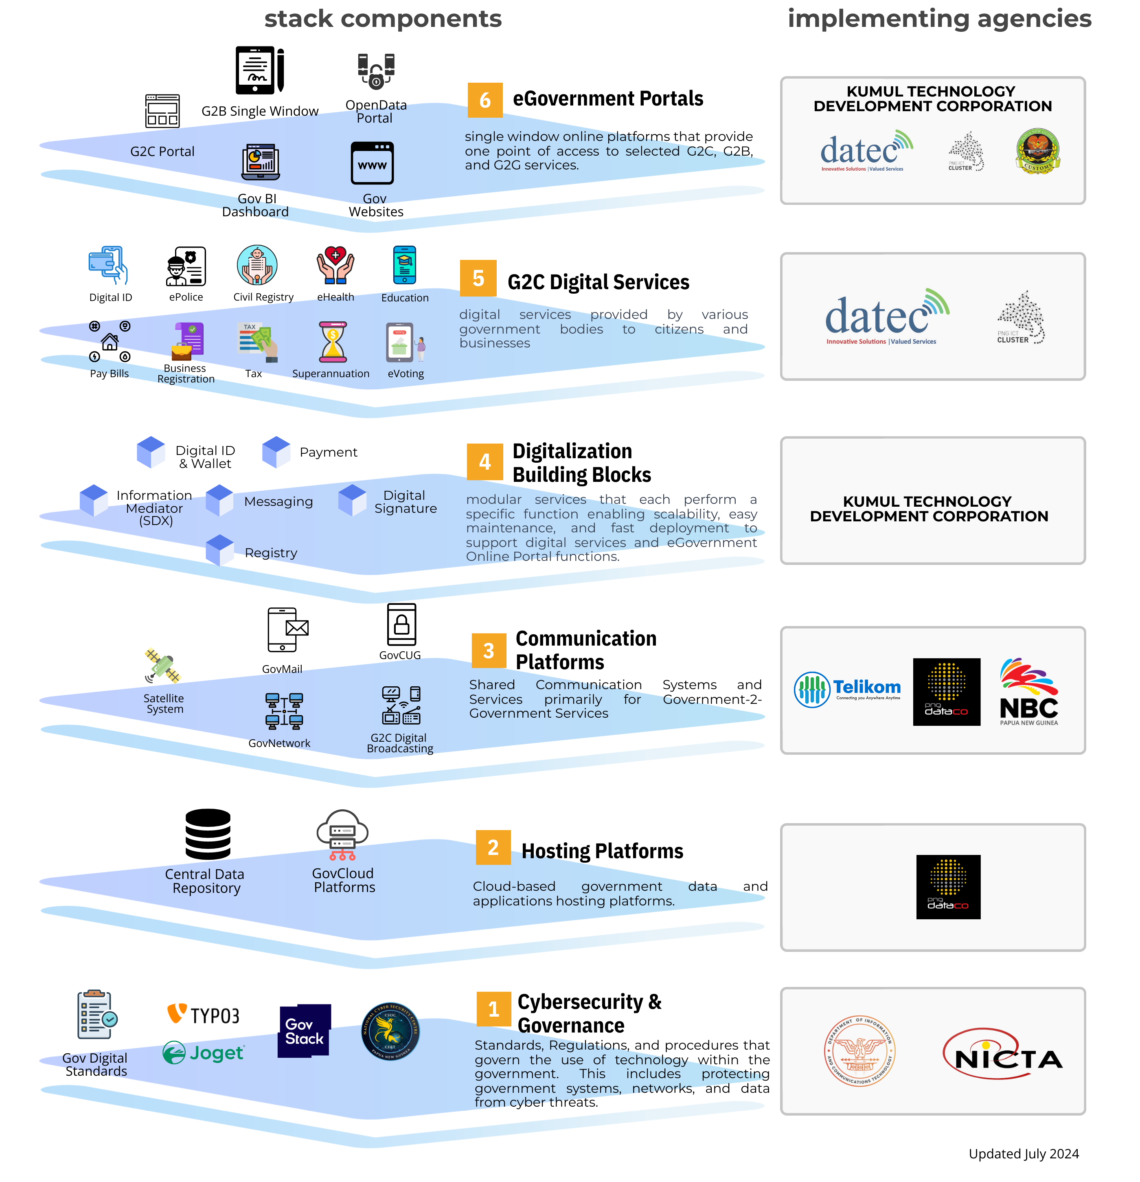
GovPNG Tech Stack & Implementation Framework
A national framework to guide the use of technology therefore enable a digital government for Papua New Guinea
Developing an Inclusive implementation framework to which all stakeholders can participate

Slide 13













BUILDING DIGITAL PUBLIC INFRASTRUCTURE AROUND THE EGOVERNMENT PORTAL
DIGITAL SERVICES
SHARED MICRO SERVICES
HOSTING AND COMMS INFRASTRUCTURE
Government
User Interface
Back-End
Reusable Building Blocks
ePolice
Identity
Pay Bills
...
Payment
Education
Wallet
EGOVERNMENT PORTALS
...
G2C User Interface
Partners

Slide 14
DIGITAL ID AS A DIGITAL PUBLIC INFRASTRUCTURE
Core Services:
Identity Registration & Enrolment.
Authentication & SSO.
KYC Services.
Digital Signatures.
Consent & Credential Management.
Role-Based Access Control.

Slide 15
DIGITAL ID ECOSYSTEM

Slide 16
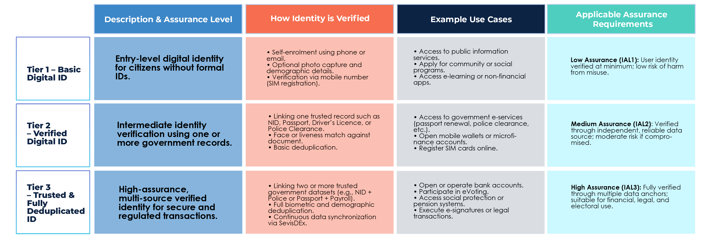
A Tiered Strength Digital ID Ecosystem

Slide 17



G2C DIGITAL ECOSYSTEM
Private Sector - Relying Partners
Banks
Telcos
Police Clearance
Crime Reporting
eHealth Registration
School Fee Management
Grade 12 Certificate
Common Roll Registration
Water Bill Management
Power Bill Management
eVoting

Slide 18









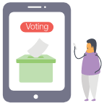








ePolice
Civil Registry
eHealth
CITIZEN'S EGOV PORTAL
Digital ID
Education
THE ROLE OF KTDC
Kumul Tech will need to support digitalizing a wide range of G2G, G2B, G2C Services
Kumul Tech will utilize emerging tech like AI to improve operational efficiencies of SOE.
Kumul Tech will innitially role out the Digital ID and Payment, and Portal Ecosystem
Pay Bills
Business
Registration
Tax
Superannuation
eVoting
G2G EGOV PORTAL
eCabinet
Procurement
Management
Payroll
eParliament
State Contract
Management
eLegislation
HRM
Finance
INVESTMENT PORTAL
Business
Registration
Sector Permit
Tax
eProcurement
Notes:
Samson to add comments while steve leads

Slide 19

ECONOMIC TARGETS BY 2027
DIGITAL SERVICE TARGETS FOR 2027
85%-90% 4G and 30% 5G connected
8 million digital ID issued
5 million with bank account
150 digital services offered
eVoting in 2027
ECONOMIC TARGETS FOR 2027
30%-50% annual increase in Non-Tax Revenue
20% annual increase to GST
KCH Subsidiary that grosses K1 billion

Slide 20
