Slide 1
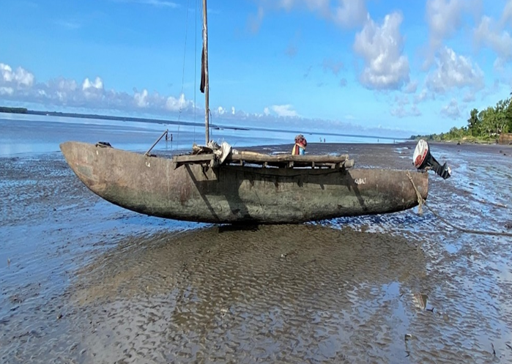

Investment Trends to Watch in PNG John Tuaim, Deputy CEO & Chief Investment Officer Petroleum & Energy Conference, 8th Oct 2025
All photos taken in Western Province by Mr. Kini Renagi..

Slide 2

Agenda
Education Sector
Tourism & Hospitality Sector
Consumer & Retail Sector
Agriculture Sector
Petroleum & Energy Sector
Conclusion

Slide 3

Education Sector
Young population
About 6 universities and various technical schools
Focus on technical schools
Can easily support the Australian and international labor force
Can easily support PNG’s manufacturing sector
Cheaper but quality workers

Slide 4

Tourism and Hospitality Sector
Only three hotel brands in PNG
Demand growth in the coming years due to:
Mining and Petroleum Projects
NRL games in Port Moresby
Local Tourists
Improvement in Airlines
Air Niugini - new planes
PNG Air
Investment into centres outside of POM
Kikori
Kutubu
Tari
Kerema

Slide 5
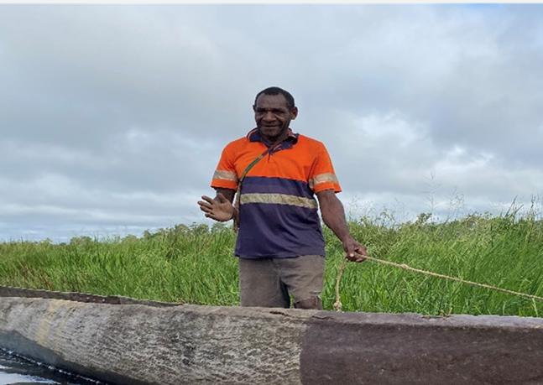
Consumer and Retail Sector
Fast Food
Department Stores
Motor Vehicles (EVs)
Modern Private Health Care Services

Slide 6

Agriculture Sector
Domestic Consumption
Replace imports
10 million plus consumers
Cash Crops
Coffee
Cocoa
Rubber
Down Stream Processing
Notes:
Coffee – 39,000 tonnes in 1975 to around 55,000 tonnes annual now and 2024 USD156m export earnings
Cocoa – K1.2b in 2024, first half of this year we are already at K1.2b Over K4billion from cashcrops is 2024

Slide 7

Petroleum & Energy Sector
Mining and Petroleum Projects
Associated activities
Exploration
Energy (Green)
Data centres
Crypto mining centres
Rural Electrification

Slide 8

Conclusion
”It is coming. It is a question of time. We must be ready when it comes”…..

