Slide 1
iCOM rewards Employee benefits and members rewards
November 2021
Presented by Jamie Tye

Slide 2
Nice to meet you !
Jamie Tye
12 months with iCOM and 25 years in sales
Passionate about customer services and the Employee experience
Helping the hospitability sector to attract and retain employees
Account management
Mental health in the work place

Slide 3

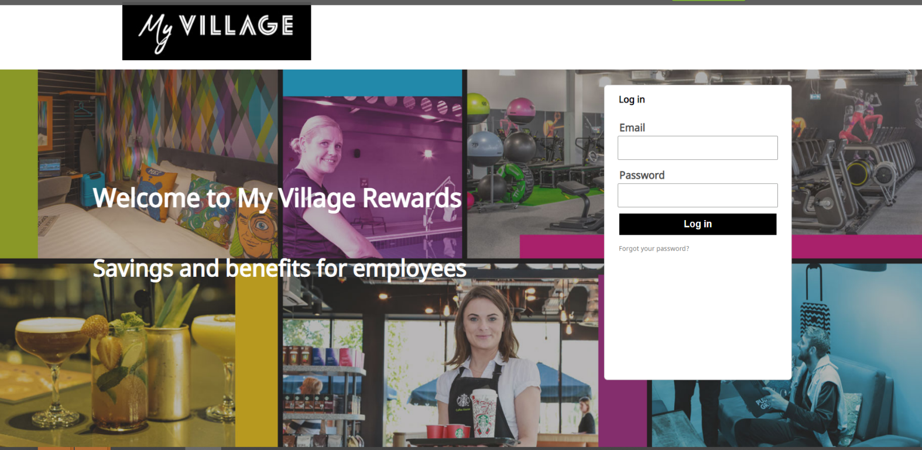
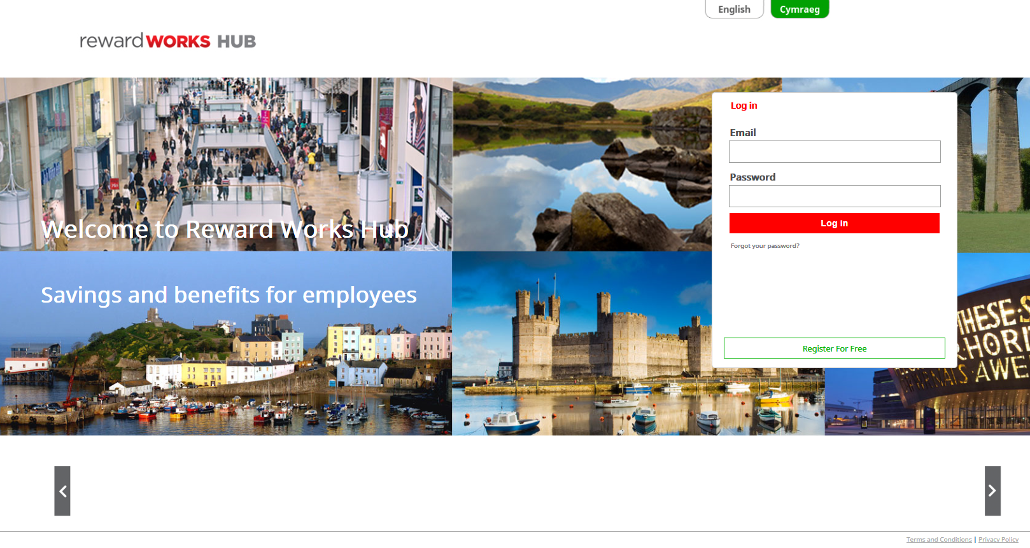


An Integrated Solution – Fully branded Home Login Page
An Integrated Benefit & Reward Solution From iCOM

Slide 4
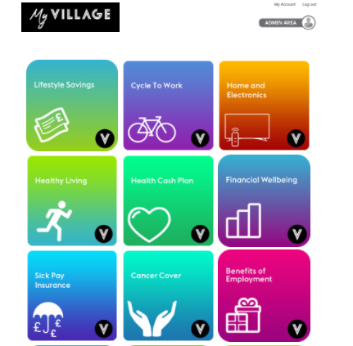

fully branded one stop employee benefits, Reward and wellbeing platform landing page
An Integrated Benefit & Reward Solution From iCOM

Slide 5
Current Product Range
Cycle to Work Scheme
Car Service Scheme
Green
Car Scheme
Voluntary Benefits
Lifestyle & Consumer Savings
Childcare Voucher Scheme
Home Tech Scheme
Health & Wellbeing
Resource Centre and Savings
Healthy Living Hub
Loans Pensions Savings
Reward
Peer-to-Peer & Recognition
Employee Assistance Program
Retail & Leisure Savings
Reward HUB
Benefits Engagement Platform
Reward HUB
Tb Proprietary Product
Financial Wellbeing
Vectis Card
Exclusive Partner Product
Health Insurance & Cash Plans
Employer Work Benefits
2 or more Product Partners
Gym Member Scheme
Travel to Work Schemes
18 Product Categories
24 Product Partnerships
33% increase on 2021
Reward P2P
Reward Recognition
Holiday Exchange Scheme
Notes:
3 MINS
Engagement and Penetration % points is everyone’s new currency
Systems – RMS
Platform features EG SSO
Comms Team enlargement

Slide 6


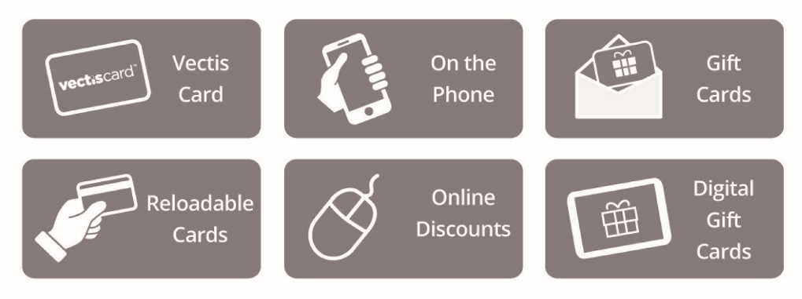
Simply click on the Lifestyle Savings tile within the hub platform to access and enjoy offers and discounts at 1000’s of
big-name brands with a number of simple and easy ways to save…
An Integrated Benefit & Reward Solution From iCOM

Slide 7
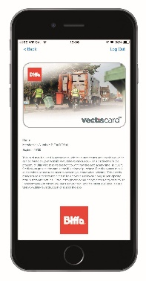



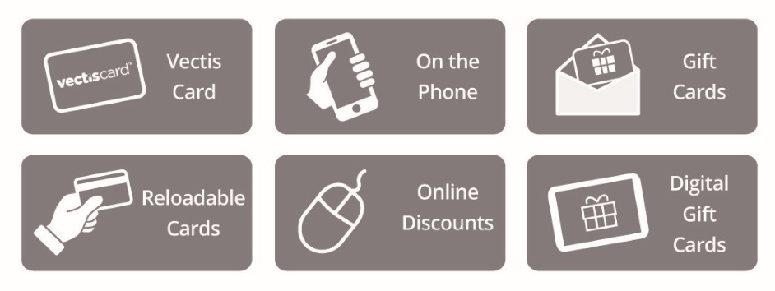




Vectis Card
Gift Cards
Simply show your fully branded digital Vectis Card on your phone to receive discounts at hundreds of participating retailers
Purchase a Gift Card and receive discount on the price when purchasing
Get a £1,000 TUI Gift Card but you only pay £960 – still receiving the full value of £1,000 on the card!
On the phone
Visit the offer page, phone the instructed number and quote the relevant code to get discounts on Sky TV packages and broadband!
Instant Digital Vouchers
Reloadable Cards
Purchase a reloadable card and save on your weekly/monthly shopping! This is a card which is first sent in the post but then regularly topped up at a discount
Get a £100 Tesco Reloadable Card but only pay £96 – still receiving the full value of £100 on the card!
Purchase a Instant Digital Voucher that will come through to your email address instantly*
Get a £100 Miller and Carter digital Voucher but you only pay £90 – still receiving the full value of £100 on the card!
Online Discounts
Select a chosen retailer – follow the instructions on the offer page via a pre-discounted link or exclusive discount code
Get 10% off at Apple
An Integrated Benefit & Reward Solution From iCOM

Slide 8


Fully branded Vectis Discount Card
Fully branded and personalised to the employee, which can be integrated with Forth
Accepted at the leading retailers, gyms, restaurants, cafes etc
User friendly and engaging, the employee simply shows the card at the point of sale to obtain a discount (no codes or vouchers required)
Can be used for double savings alongside digital vouchers and reloadable shopping cards
An Integrated Benefit & Reward Solution From iCOM

Slide 9
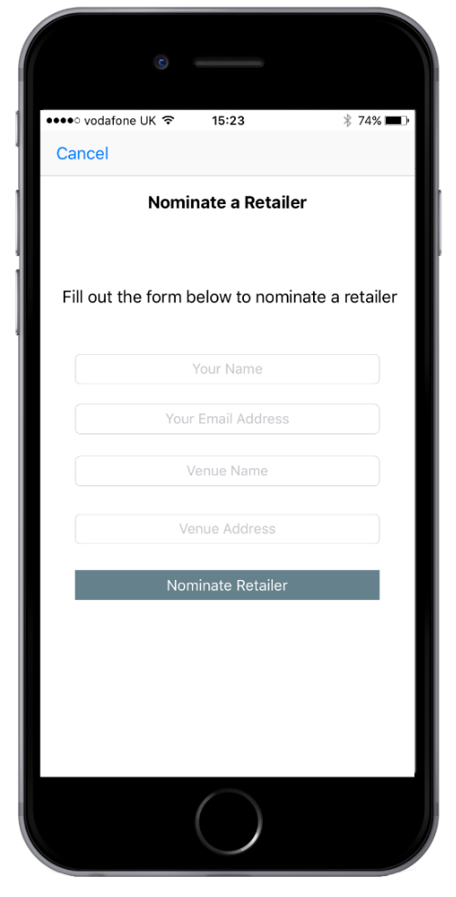
Vectis Card Nominate a Retailer
Employees can nominate where they would like to use and save with the Vectis Card within their local area and iCOM will negotiate a discount on behalf of the employees
Discount agreed and contracted with the retailer, Cafe, restaurant etc (no charge)
iCOM will e-mail the employee advising of discount rate agreed on behalf the client
Allows all employees to build their own relevant savings within their local area where they spend money regularly.
An Integrated Benefit & Reward Solution From iCOM

Slide 10


Convenient access to a qualified GP 24/7
Employees will have access to a 24/7 Private GP telephone consultation line or online Doctor consultation and instant digital prescriptions
For quick and convenient advice and reassurance, with 24/7 access to a qualified GP consultation service. No matter how big or small the illness or how serious the symptom you can call the GP consultation service and speak to a GP. Providing advice, diagnosis and reassurance all at a time to suit you.
To arrange your private GP telephone consultation or your online doctor consultation simply book online or call the relevant support telephone number to arrange the appointment.
An Integrated Benefit & Reward Solution From iCOM

Slide 11


Employee Assistance Programme
The 24/7, 365 days a year telephonic Employee Assistance Programme is a confidential and private support line where employees can get instant help and support to cope with stress, personal issues, anxiety and much more.
Receive personal legal and financial information from Citizen Advice trained information specialists, face-to-face counselling from BACP approved councillors and also access to a telephone counselling service
Employees can also access a support and wellbeing online platform with access to self help workbooks which provides resource and support
An Integrated Benefit & Reward Solution From iCOM

Slide 12



Employee Health and Wellbeing platform
Free home and on the go online fitness videos and popular workouts such as Yoga, Pilates etc
Healthy eating and diet tips including meal recipes and videos
Articles, videos and advice covering all of the key subjects of Health and Wellbeing such as Health, Body, Mind, Financial, Fitness and Lifestyle
Employee health care cash plan covering the costs of dental, opticians, physio etc
The Five ways to wellbeing from our mental health charity that we support ‘’Mind’’.
An Integrated Benefit & Reward Solution From iCOM

Slide 13


Employee paid for Health Care Cash Plan
For a small monthly contribution employees and their families can save hundreds of pounds by claiming money back on a wide range of everyday healthcare costs including dental, optical and physio therapy treatments, plus much more.
An Integrated Benefit & Reward Solution From iCOM

Slide 14

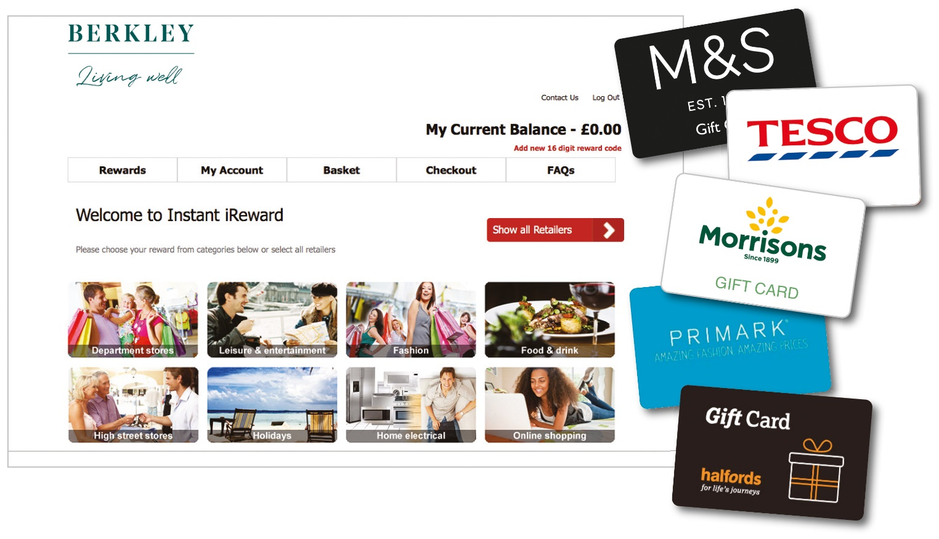

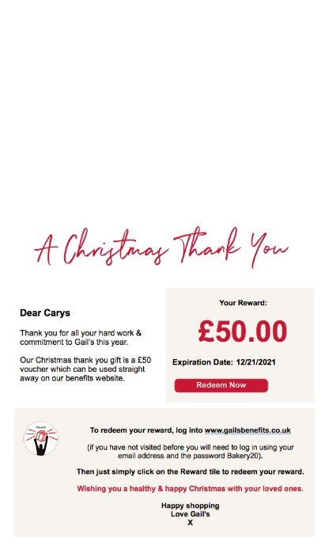
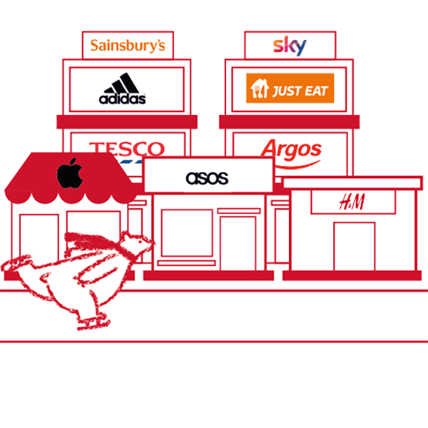
Instant Employee Reward and Recognition
Employees can receive instant digital monetary rewards for any company millstone such as long service awards, Birthdays, employee of the month, outstanding work etc
The monetary rewards platform can be integrated within the one stop benefits and wellbeing platform and redeemed/spent within one platform
Fully branded employee comminutions notifying employees of the Reward
Monetary rewards can be redeemed and spent at across over 250 brands on the both online or instore
An Integrated Benefit & Reward Solution From iCOM

Slide 15

Fully branded employee communications and engagement
All schemes include a fully branded digital or physical welcome pack for each employee, we manage the fulfilment by sending all employees a welcome email at launch of the platform and ongoing for new joiners
Dedicated Client Relationship Manger
Weekly ongoing email communications including branded employee e-shots and platform notifications promoting the discounts and products
Webinars both before and after the platform launch and supporting media to promote and engage the employees
24/7 access to our administrator toolkit which provides weekly new communications, posters, leaflets and specific media
An Integrated Benefit & Reward Solution From iCOM

Slide 16
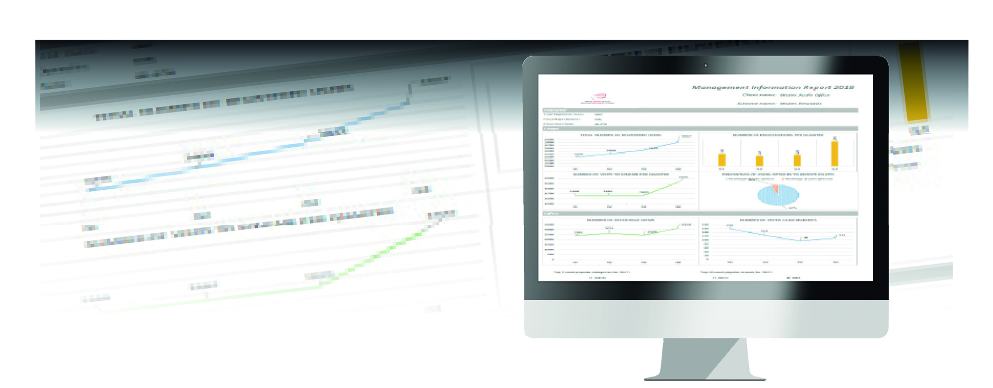
Real Time Management Information
Real time access to scheme usage statistics available via the Administrator Toolkit
Registered users and active registered user
Login and click through rates
Categories of spend on employee usage such as top offers used, retailers, retailers categories etc
Vectis Card Wishlist requests
E-shot opt in and open rate statistics
Usage – Traffic Hub tile click through rates
Offers – Development & Employer Specific
Customer Service & Enquires
An Integrated Benefit & Reward Solution From iCOM

Slide 17



Thankyou all for your time today and
I’m sure that you have had enough of me speaking!
Now its over to you for any questions?
 | Jamie Tye Business Development Manager T 029 2073 2070 M 07555 967080 E jamie@icomworks.co.uk
An Integrated Benefit & Reward Solution From iCOM

