Slide 1
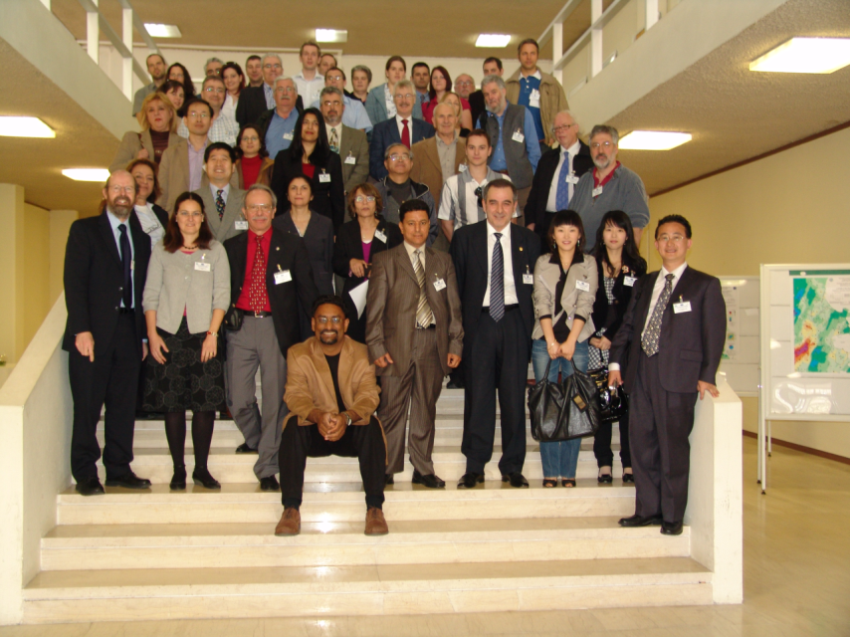

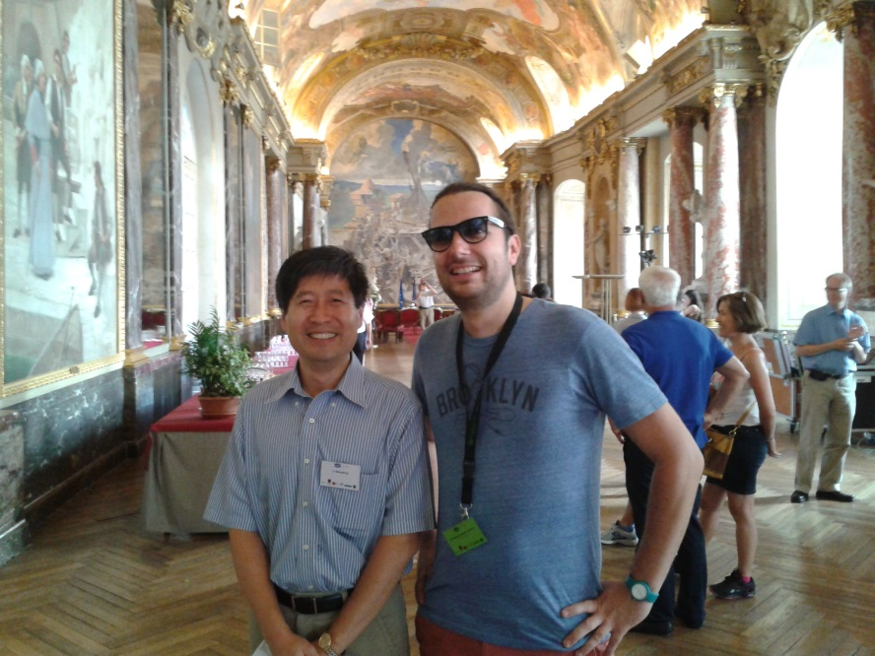
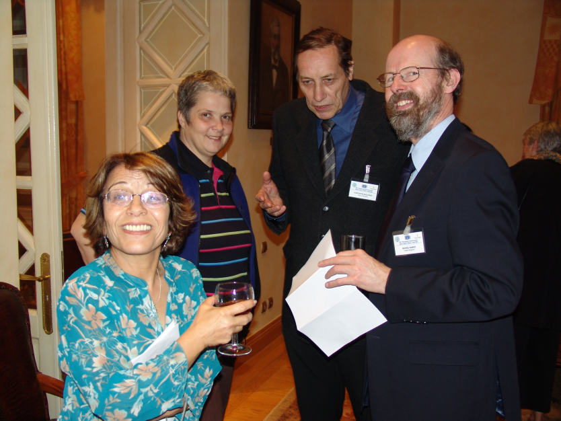
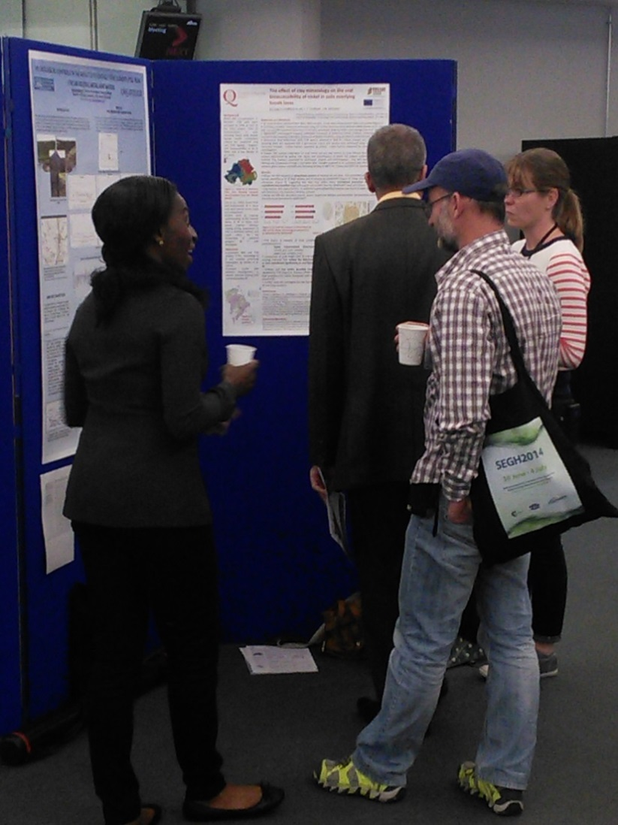
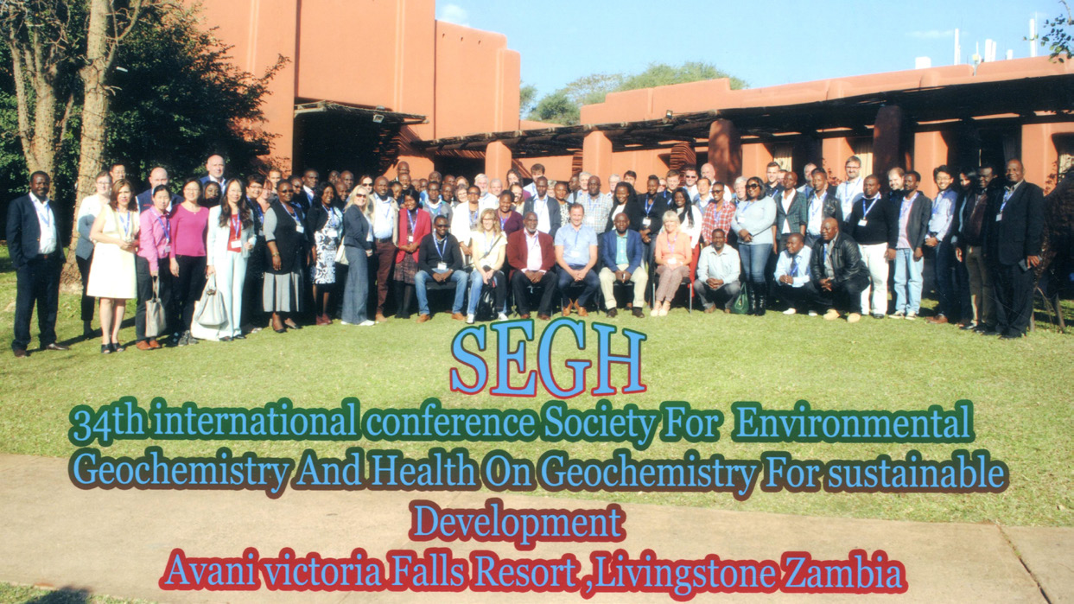
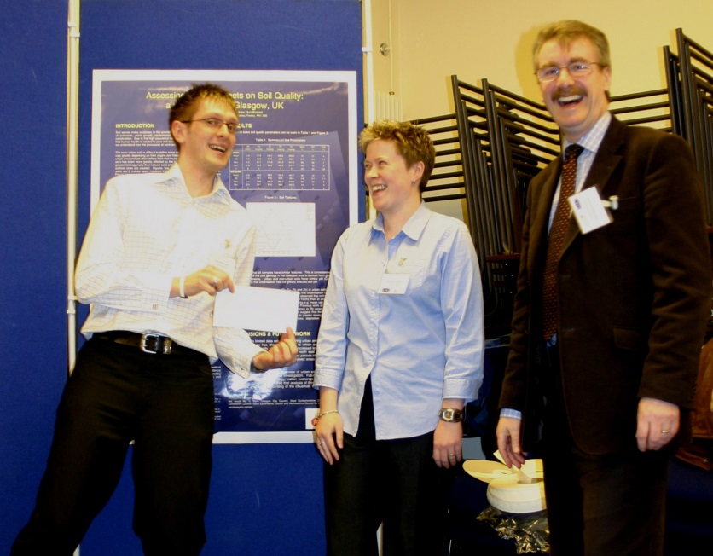
http://www.segh.net

Slide 2

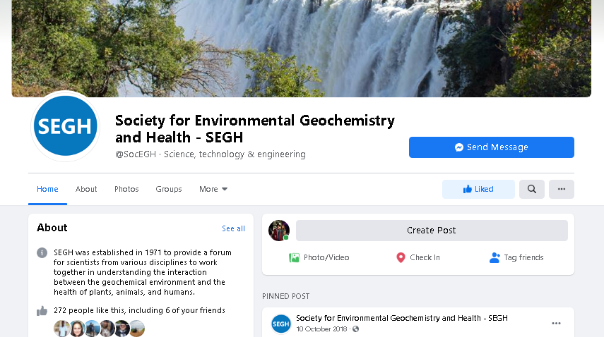
Proud history – rich future
Established in 1971
“interaction between the geochemical environment and the health of plants, animals, and humans”
Committed to challenges of interdisciplinary work
https://www.facebook.com/SocEGH/
http://www.segh.net/

Slide 3
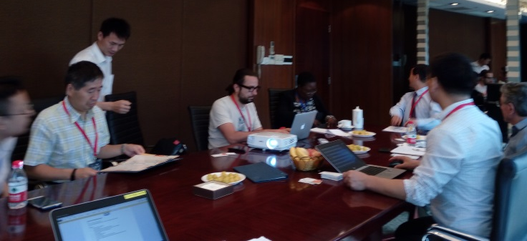
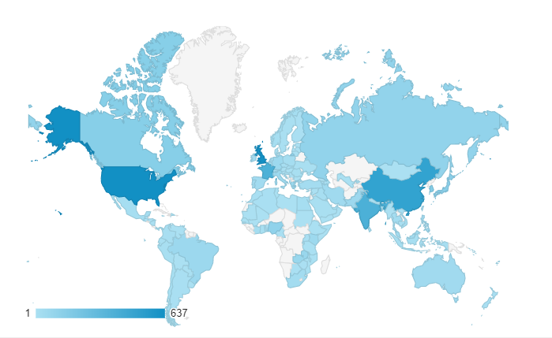
Who we are
Governance:
President
Africa Chair
European Chair
Americas Chair
Asia/Pacific Chair
Membership Secretary/Treasurer
Secretary
Webmaster
Board Members to cover ECR and related activity – conference hosts
http://www.segh.net
International interest and activity

Slide 4

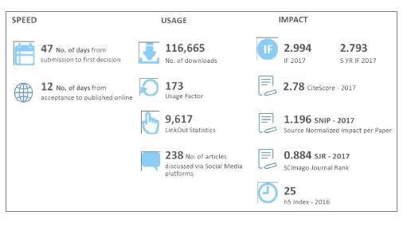
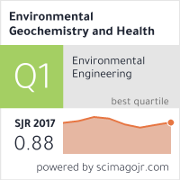
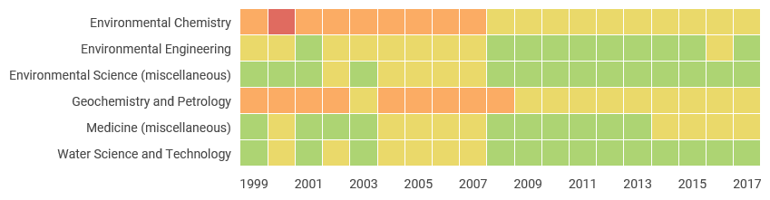
The SEGH Springer Nature Journal
Journal ranking (quartile)
http://www.segh.net

Slide 5
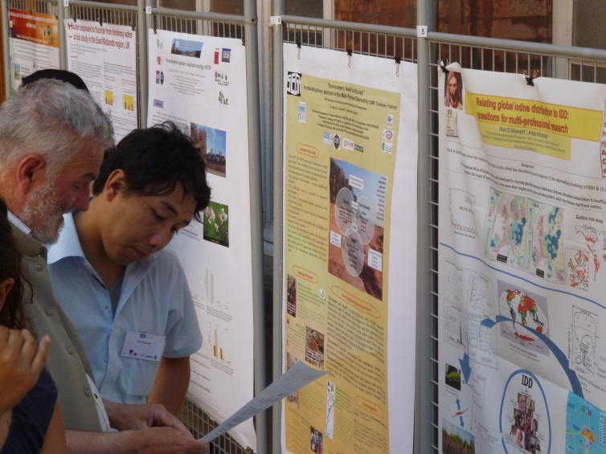
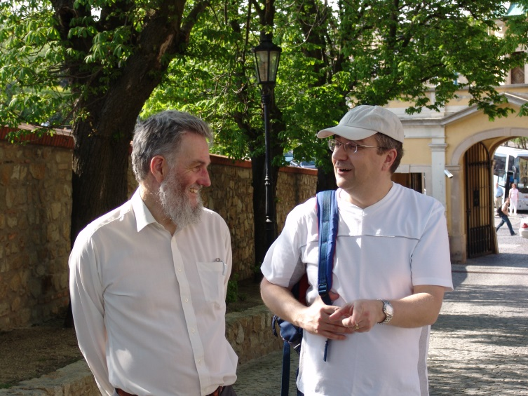
Join us
Society for Environmental Geochemistry and Health
International & interdisciplinary,
International & regional networking,
working with other groups,
Early Career Mentoring Scheme,
From 2019 Categories of membership
  Fellow of SEGH*
  Member of SEGH
  DAC ODA⁺ country Member of SEGH
  Student Member of SEGH
⁺ www.oecd.org
http://www.segh.net/home
https://twitter.com/SocEGH
* Nomination of a SEGH member for significant contribution to the Society, approved by SEGH Board
https://www.facebook.com/SocEGH/

Slide 6
Family!
Society for Environmental Geochemistry and Health
The SEGH Family
http://www.segh.net/home /

